Slide 1
GENERAL PATHOLOGY (OPT 327) BY
PROF(MRS) FAUSTINA IDU
B Sc, OD, PhD, FNCO, FAAO

Slide 2
COURSE OUTLINE
INTRODUCTION TO PATHOLOGY
Definition
Branches of Pathology
HEALTH
DISEASE
Causes of disease
PATHOLOGICAL PROCESSES
The Cell

Slide 3
COURSE OUTLINE
Cellular Adaptation
Cell injury: Reversible and irreversible
Cell death: Necrosis and Apoptosis
Somatic death
INFLAMMATION
Acute inflammation
Chronic inflammation
HEALING AND REPAIR

Slide 4
COURSE OUTLINE
ONCOLOGY
IMMUNOLOGY AND IMMUNOPATHOLOGIES
FLUID AND HAEMODYNAMIC DERANGEMENT
FLUID DERANGEMENT
Dehydration
Oedema

Slide 5
COURSE OUTLINE
HAEMODYNAMIC DERANGEMENT
Hyperaemia or congestion
Ischemia
Hemorrhage
Shock

Slide 6
COURSE OUTLINE
OBSTRUCTION TO BLOOD FLOW
Thrombosis
Embolism
CARDIOVASCULAR DISEASES
SYSTEMIC DISEASES
INFECTIOUS DISEASES

Slide 7
INTRODUCTION
What is pathology?
Pathology is the study and diagnosis of disease.
The word pathology is a Greek word:
Pathos :"feeling, suffering";
logia, "the study of“
It is the study of the structure and function of the body in disease.

Slide 8
INTRODUCTION
Pathology addresses 4 components of disease:
1. Cause/etiology,
2. Mechanisms of development (pathogenesis),
3. Structural alterations of cells (morphologic changes),
4. Consequences of changes (clinical manifestations).

Slide 9
INTRODUCTION
General pathology
This is also called investigative pathology, experimental pathology, or theoretical pathology
It is a broad scientific field
It seeks to understand :
1. The mechanisms of injury to cells and tissues,
2. The body's means of responding to and repairing injury.

Slide 10
INTRODUCTION
General pathology forms the foundation of pathology.
The application of this knowledge is used to diagnose diseases in humans and animals.

Slide 11
INTRODUCTION
BRANCHES OF PATHOLOGY
The broad branches of pathology include:
Anatomical pathology and
Clinical pathology

Slide 12
INTRODUCTION
ANATOMICAL PATHOLOGY
This area of pathology involves the examination of surgical specimens removed from the body (biopsy) to investigate and diagnose disease.
On examining a biopsy, the following aspects are considered:

Slide 13
INTRODUCTION
Gross anatomical make up of the sample
Microscopic appearance of cells
Chemical signatures in the sample
Immunological markers present in the cells
Molecular biology of the cells, organs, tissues and sometimes whole body

Slide 14
INTRODUCTION
Anatomical pathology is itself divided in subspecialties, the main ones being :
Surgical pathology - This involves the examination of specimens obtained during surgery such as a breast lump biopsy obtained during mastectomy
Histopathology - This refers to the examination of tissue samples under a microscope after they have been stained with appropriate dyes.

Slide 15
INTRODUCTION
Cytopathology - In cytopathology, cells that have been shed into bodily fluids or have been obtained by scraping or aspirating tissue are examined. Typical examples include cervical smear, sputum and gastric washings.
Forensic pathology- involves the post mortem examination of a corpse for cause of death using a process called autopsy.
Dermatopathology -focuses on the study of cutaneous diseases at a microscopic and molecular level

Slide 16
INTRODUCTION
CLINICAL PATHOLOGY
Clinical pathology is concerned with the diagnosis of disease based on the laboratory analysis of body fluids such as blood and urine, and tissues using the tools of chemistry, microbiology, hematology, immunology and molecular pathology.

Slide 17
INTRODUCTION
The branches of clinical pathology include:
Chemical pathology, also called clinical chemistry, involves the assessment of various components in bodily fluids such as blood or urine, although for the main part it concerns the analysis of blood serum and plasma.

Slide 18
INTRODUCTION
Hematology or hematopathology is the study of the morphology and physiology of blood.
It is concerned with the investigation, diagnosis and monitoring of diseases of blood and blood-forming organs.
Immunology or immunopathology refers to the study of immune system disorders such as immunodeficiencies, organ-transplant rejection and allergies.

Slide 19
INTRODUCTION
Molecular pathology
Molecular pathology is a multi-disciplinary field that focuses on disease at the sub- microscopic, molecular level.
Aspects studied may include a mixture of anatomical pathology, clinical pathology, genetics, molecular biology and biochemistry.

Slide 20
HEALTH
HEALTH
Health is the level of functional and or metabolic efficiency of a living organism at both the micro (cellular) and macro (social) level.
Health is commonly defined as an organisms ability to efficiently respond to challenges (stress) and effectively restore and sustain a state of balance (homeostasis).

Slide 21
HEALTH
Another widely acceptable definition of health is that of WHO.
It states that :
“Health is a state of complete physical, mental, and social well being and not merely the absence of disease or infirmity.”

Slide 22
DISEASE
DISEASE
A disease or medical condition is an abnormality of the body or mind that causes discomfort, dysfunction, distress or death to the person afflicted.
It is an abnormal variation in the structure and function in any part of the body
or a change in the condition of an organisms complete adaptation to its environment as a result of which the organism suffers from discomfort or disease (dis – ease).

Slide 23
DISEASE
CAUSES OF DISEASE
Congenital/Genetic causes
Acquired causes

Slide 24
DISEASE
Congenital Disorders
Congenital disorders also known as birth defects are represented by disease entities that may develop during fetal life as well as those that may arise and manifest themselves clinically during post-natal life.
They are conditions existing at or before birth regardless of cause.

Slide 25
DISEASE
Of these disorders, those characterized by structural deformities are termed congenital anomalies and involve defects in a developing fetus.
Congenital disorders may be genetic or environmentally acquired.
Any substance that causes congenital disorders is known as TERATOGEN

Slide 26
DISEASE
Genetic disorders
Genetically determined diseases are commonly congenital, although some may present many years after birth.
e.g. polyposis coli (multiple disease function) which is due to dominant abnormal gene and consists of multiple tumours of the colonic mucosa appearing in adolescent adult life

Slide 27
DISEASE
Genetically determined diseases are due to some abnormalities of the base sequence in the DNA of the fertilized ovum and the subsequent cells that are derived from it
or may be due to reduplication, loss or misplacement of the whole or part of the chromosome

Slide 28
DISEASE
Such abnormalities are often inherited from one or both from parents.
The development of an abnormal gene can be provoked by radiation, mutagenic chemical and probably by viruses.
In most instances the cause of mutation in Man remains unknown.
Examples of many conditions that result from abnormal gene are colour blindness, albinism, sickle cell anaemia, polyposis coli etc.

Slide 29
DISEASE
The abnormal gene may be dominant i.e induces an abnormality inspite of a normal corresponding gene of the other parent.
It may be recessive i.e it causes disease only in the absence of a corresponding normal gene.

Slide 30
DISEASE
Environmentally Acquired Congenital disorders
Congenital diseases may be acquired.
Infection
For example in the transmission of the virus of rubella (German Measles) from mother to fetus during the 1st trimester of pregnancy,
Depending on the stage of fetal development at which infection occurs,
It may result in the following:

Slide 31
DISEASE
Fetal death or involvement of various tissues leading to mental deficiency, blindness, deafness or structural abnormalities of the heart.
Mother may also transmit to the fetus various other infections including syphilis and toxoplasmosis with consequent congenital disease.

Slide 32
DISEASE
Chemicals
Ingestion of various chemicals by the mother as in the THALIDOMIDE disaster may induce severe disorder of fetal development and growth of children born to mothers who ingest these chemicals in the 1st trimester of pregnancy.

Slide 33
DISEASE
Immunological factors
At other times, the acquired agent or disease may not necessarily be from outside it may be factors that are originating from the mother who during a second pregnancy develops toxic antibodies on their Red blood cells (RBC) transferable to the fetus causing haemolysis of RBC.
Trauma
Trauma to the fetus in the uterine environment through the mother can lead to congenital anomaly.

Slide 34
DISEASE
ACQUIRED CAUSES OF DISEASE
This is due to effects of some environmental factors.
Many factors e.g malnutrition or micro organism.
Most diseases are acquired either singly or through the contribution of factors.
It is worthy of note that genetic variation of an individual can influence environmental factor in causing acquired diseases.

Slide 35
DISEASE
Even in case of infections, there is considerably individual variation in the severity of the disease.
e.g of the many individuals who become infected with polio virus most develop immunity without becoming ill, some have a mild illness or some becoming paralysed from the involvement of central Nervous system (CNS).
This illustrates the importance of host factors as well as causal agents.

Slide 36
DISEASE
The spread of TB is favoured by poor and personal Hygiene, by overcrowding, malnutrition and other various factors.
Accordingly disease results not only from exposure to major causal agents, but also from existence of predisposal agent.

Slide 37
DISEASE
The causal agents may be classified as follows
Deficiency diseases or disturbances of nutrition
Physical agents
Chemicals
Micro organisms
Immunological factors
Psychological factors

Slide 38
DISEASE
Deficiency diseases/disturbances of nutrition
Inadequate diets accounts for poor health in many part of the world.
It may take the form of deficiency of either the four classes of food usually high grade protein, of vitamins or elements essential for metabolic processes e.g iron for Haemoglobin production.
Often the deficiencies are multiple and complex.

Slide 39
DISEASE
In affluent countries of the world, Obesity due to over eating has become increasingly common with its consequences as high blood pressure, heart diseases and diabetes mellitus.

Slide 40
DISEASE
Physical agents
These include mechanical injury, heat, cold, electricity, Radiation and rapid changes in environmental pressure.
In all instances, injury is caused by a high rate of transmission of a particular form of energy to or from the body

Slide 41
DISEASE
Common causes of mechanical injury in Africa is (RTA) Road Traffic Accidents, burns etc.
Exposure to ionizing radiation is not entirely safe in any dosage.
Radiation is beneficial in various diagnostic and therapeutic procedures but any pollution of the environment with radioactive material is potentially harmful to those exposed to it and probably to its subsequent generations.

Slide 42
DISEASE
Chemical agents
With the use of an ever increasing number of chemical agents as drugs in industries and in the homes, chemically induced injury has become very common.
In one extreme are those substances which have a general effect on cells such as cyanide which causes death almost instantaneously with little or no structural changes.

Slide 43
DISEASE
Many other chemicals such as strong acids and alkali cause local injury accompanied by an inflammation reaction in the tissue exposed to them.
A 3rd large group of substances produces a more or less destructive injury within a particular organ or a cell type because of their importance and complex metabolic activities.

Slide 44
DISEASE
Hepatocytes are injured by many chemical substances including paracetamol in large dosage and alcohol in high doses.
Specific injures of chemicals are illustrated also by injury of nerves by overdose of barbiturate and lung injury by paraquat (Chemical used for weeding).

Slide 45
DISEASE
Microorganisms:
These include bacteria,
protozoa,
lower fungi and
viruses.
many important diseases still result from infections by microorganism despite advances in immunization procedures and the extensive use of antibiotics,
Danger of wide spread epidemics e.g of influenza, covid and cholera has been enhanced by air travel.

Slide 46
DISEASE
The disease producing capacity of microorganisms depends on their ability to invade and multiply within the host and the possibility of their transmission to other hosts.
The features of the disease produced by infection depends on the specific properties of the causal organisms.
The biological effects of these microorganisms together with the response of the host determines the features of the disease.

Slide 47
DISEASE
Bacteria
Bacteria brings about harmful effects mainly by the production of chemical compounds termed toxins.
Viruses
Viruses colonize host cells and have a direct cytopathic effect on them
Features of viral diseases depends largely on:
which cells are colonized,
the site of viral replication,
the nature of the cytopathic effect
and the response of the host.

Slide 48
DISEASE
Protozoa
Of the protozoa, the malaria parasite is of enormous importance as a cause of chronic ill health in many populations.

Slide 49
DISEASE
Immunological factors
The development of immunity is essential for protection against microbes and parasites.
However, this protection which man acquires may become harmful and causes disease.
The immune system does not distinguish between harmful and harmless foreign antigenic materials and an injury may result from immune reactions to either.

Slide 50
DISEASE
Such hypersensitivity reactions are numerous and complex.
Local example include hay fever, asthma and some forms of dermatitis.
Hypersensitivity to many foreign materials including penicillin and other drugs sometimes causes fatal generalized reactions.

Slide 51
DISEASE
Psychogenic factors
The mental stresses imposed by conditions of life particularly in technologically advanced communities are probably largely responsible for three important and overlapping groups of diseases.

Slide 52
DISEASE
1. Acquired Mental diseases
SCHIZOPHRENIA and
DEPRESSION for which no specific structural or biochemical basis has been found.
2. Disease of addiction particularly to alcohol, various drugs and tobacco.
These result in psychosomatic diseases.
e.g alcohol predisposes to liver damage and causes various neurological and mental disturbances
cigarette smoking is the major cause of lung cancer and chronic bronchitis.
It is also concerned with peptic ulceration and coronary artery disease.

Slide 53
DISEASE
3. Heterogenous
Includes peptic ulcer, high blood pressure and coronary artery disease.
In these three important conditions, anxiety, overwork and frustration appears to be the causal factors although their modes of action are obscure.

Slide 54
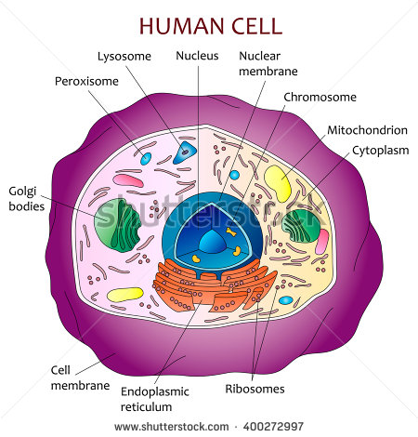
PATHOLOGICAL PROCESSES

Slide 55
PATHOLOGICAL PROCESSES
The cell is the functional unit of all tissues
It has the capacity to perform individually all the essential life functions within the various tissues of the body.
Mammalian cells have an extraordinary range of morphological forms yet all cells conform to a basic model of cell structure.
All metabolism of the body are carried out and regulated by the cells of the tissue.
Cells are active participants in their environment constantly adjusting function and structure to accommodate changing demands in extra cellular stress.

Slide 56
PATHOLOGICAL PROCESSES
All disturbances of function and structure in disease are due to cellular abnormalities.
The phenomena of a particular disease are brought about by a series of cellular changes.
It is important to know the pathway of mechanism through which the cells are damaged because their damage gives rise to disease.

Slide 57
PATHOLOGICAL PROCESSES
Pathological processes are of a dual nature consisting of:
The changes of the injury induced by a causal agent and
2. The reactive changes which are often closely similar to physiological processes.
If death is rapid as for example, in cyanide poisoning, there may be little or no structural changes of either type.

Slide 58
PATHOLOGICAL PROCESSES
In many instances, where cell injuries persist without killing the cell, the cytological changes are complex and those due to injuries often cannot be distinguished from those due to reaction.
Cellular injuries are therefore grouped together according to common causal factor and as a consequence exhibit similarities in structural changes.
e.g bacterial infections have certain features in common and may be further sub divided into acute and chronic infections.

Slide 59
PATHOLOGICAL PROCESSES
The features and behavior of neoplasms (tumours) are sufficiently similar to classify most tumours into two categories:
Benign (localized tumours): found within the tissue and is not life threatening
Malignant (this evades the entire body and is life threatening).

Slide 60
PATHOLOGICAL PROCESSES
CELLULAR INJURY
Cellular injury occurs when stress exceeds the cell’s capacity to cope.
The central problem of pathology is injury to the cell.
The study of cellular damage starts as a microscopic disruption of individual components of each cell, progressively reaching a macroscopic level at the level of the tissues and organs.

Slide 61
CELLULAR INJURIES
During the process of cellular disruption, there is disruption of :
Biochemical,
Biophysical and
Anatomical structure of the cell.
At a time the cell is undergoing these stages following injury, a series of analysis can be carried out which can help to stop or eliminate the injury.

Slide 62
CELLULAR INJURIES
CAUSES OF CELLULAR INJURIES
Cellular injuries can be caused by genetic and acquired factors.
Acquired factors
Oxygen depletion
Hypoxia or O₂ deficiency interferes with aerobic respiration and it is an extremely importance factor among causes of cell injury and death.
Ischaemia is the most common cause of hypoxia.
Oxygen deficiency can also result from inadequate oxygenation of blood as in pneumonia or reduction of O₂ carrying capacity of the blood as in anemia or carbon dioxide poisoning.

Slide 63
CELLULAR INJURIES
Chemical agents
Any chemical agent can cause injury to the cell even glucose or salt if sufficiently concentrated in the cell can cause injury to the cell.
Oxygen at sufficiently high partial pressure is highly toxic.
Agents commonly known as poison cause severe damage at cellular level by altering
membrane permeability,
osmotic homeostasis
and can culminate in the death of the whole organism.

Slide 64
CELLULAR INJURIES
Other potentially toxic agents encountered daily in our environment include:
Air pollutant,
Insecticide,
Carbon monoxide (co),
Asbestos, e.t.c
Even therapeutic drugs can cause cell or tissue injury in susceptible patients.

Slide 65
CELLULAR INJURIES
Infectious agents:
Organisms that cause infections include viruses, bacteria, fungi, protozoa, helminth (parasitic worms).
These have diverse ways of causing cellular injuries.
Immunological reactions
immune reaction intended or incidental can result in cell and tissue injuries.
Anaphylaxis to a foreign protein or a drug is a typical example.

Slide 66
CELLULAR INJURIES
Nutritional imbalances
Nutritional deficiency remains a major cause of cell injury.
Protein calorie insufficiency among under privileged population is an obvious example.
Specific vitamin deficiencies are very common in developing and also developed nations.
Excesses of nutrition are also important causes of morbidity and mortality e.g. obesity markedly increases the risk of type II diabetes.
All over, diets rich in animal fats are strongly indicated in the development of atherosclerosis (deposit of fat)

Slide 67
CELLULAR INJURIES
Physical agents:
Trauma, extreme temperature, radiation, electric shock, sudden changes in atmospheric pressure, all have wide ranging effect on cells.
Genetic defect
Genetic defect may result in pathologic changes e.g. down syndrome, sickle cell diseases etc.

Slide 68
CELLULAR INJURIES
GENERAL PRINCIPLES RELEVANT TO MOST FORMS OF CELLULAR INJURY
The cellular response to injurious stimuli depends on the type of injury, its duration and its severity.
Thus low doses of toxins or a brief duration of ischaemia may lead to reversible cell injury where as larger toxin doses or longer ischaemia intervals may result in irreversible injury and cell death.

Slide 69
CELLULAR INJURIES
2. The consequences of an injurious stimulus depend on the type, status (nutritional), adaptability and genetic makeup of the injured cell.
The same injury has vastly different outcome depending on the cell type:
eg. striated skeletal muscles in the leg accommodate complete ischaemia up to 2-3 hrs without irreversible injuries where as cardiac muscle dies only after 20-30 minutes.

Slide 70
CELLULAR INJURIES
The nutritional status can also be very important as a glycogen replete hepatocyte will tolerate ischaemia much better than one that has just burned its last glucose molecule.
Genetic makeup of a cell can influence the response of the cell to injury.

Slide 71
CELLULAR INJURIES
3. Four intracellular systems are particularly vulnerable in cellular injury.
Cell membrane integrity
ATP generation
Protein synthesis
Intergrity of the genetic apparatus.

Slide 72
CELLULAR INJURIES
4. The structural biochemical components of a cell are so integrally connected that regardless of the initial locus of Injury, multiple secondary effects rapidly occur.
5. Cellular function is lost far before cell death occurs and
the morphological changes of cell injury or death lag far behind both loss of cellular function and cell death.

Slide 73
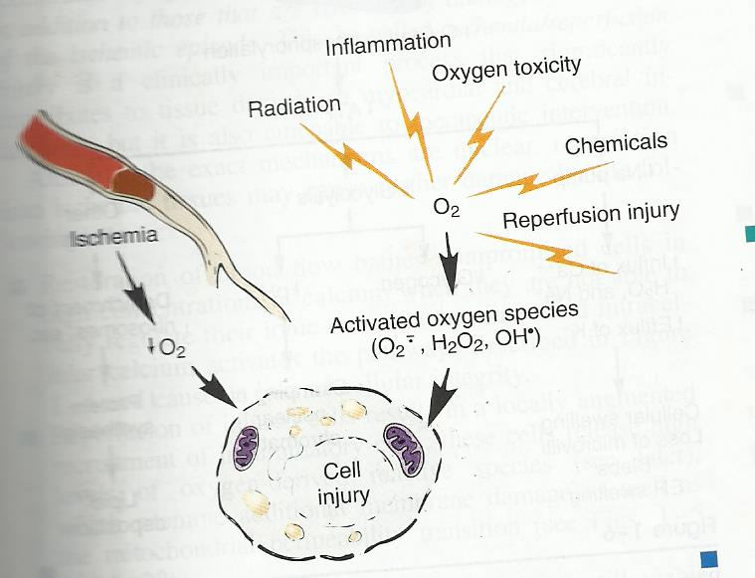
GENERAL BIOCHEMICAL MECHANISM OF CELL INJURIES
The role of oxygen in cell injury

Slide 74
CELLULAR INJURIES
GENERAL BIOCHEMICAL MECHANISM OF CELL INJURIES
ATP Depletion:
The high energy phosphate of Adenosine Triophosphate (ATP) are critical for virtually every process in the cell.
A loss of ATP synthesis results in rapid shutdown of most critical homeostatic pathways.

Slide 75
CELLULAR INJURIES
Loss of calcium homeostasis:
Ischaemia or toxins allow a net influx of extracellular calcium across the plasma membrane followed by the release of calcium in the intracellular stores.
Increased cytosolic calcium in turn activates a variety of phospholipases (promoting membrane damage).

Slide 76
CELLULAR INJURIES
Free radicals:
Examples are superoxide, anions, hydroxyl radicals and peroxides.
Free radicals are partially reduced activated oxygen species.
They cause liquid peroxidation and other harmful effect on cell structures.

Slide 77
CELLULAR INJURIES
Defective membrane permeability:
A loss of membrane barriers leads to a breakdown of concentration gradients of metabolites necessary to maintain normal metabolic activities.
The plasma membrane may be directly damaged by certain bacterial toxins etc.
Mitochondria damage: Mitochondrial integrity is critical for cell survival.
Mitochondria ends up as targets of most types of injury.

Slide 78
CELLULAR INJURIES
REVERSIBLE AND IRREVERSIBLE CELLULAR INJURIES
Cellular damage can be divided into 2
(1) Reversible injuries or cellular degeneration
(2) Irreversible cellular injuries or cell death.

Slide 79
CELLULAR INJURIES
Reversible injuries or cellular degeneration
Reversible injury is when a particular pathological change can be reversed such that it returns back to its original normal state.
E.g cardiac muscle suffering from Ischaemia for a short period of time causes reversible injury to cardiac muscle cells, so that ATP production is sustained via anaerobic respiration.
but if ischaemia is prolonged, then it will lead to irreversible injury where the pathological change is permanent and will lead to cell death.

Slide 80
CELLULAR INJURIES
Reversible injury is a lesser form of cellular damage in which the functions important for the economy of the cells are diminished and or lost but in which integrated vital functions such as respiration, membrane permeability are still possible.
In reversible injury, the pathological change can be reversed to its original state either by treatment or by removing the external stimuli causing the injury.

Slide 81
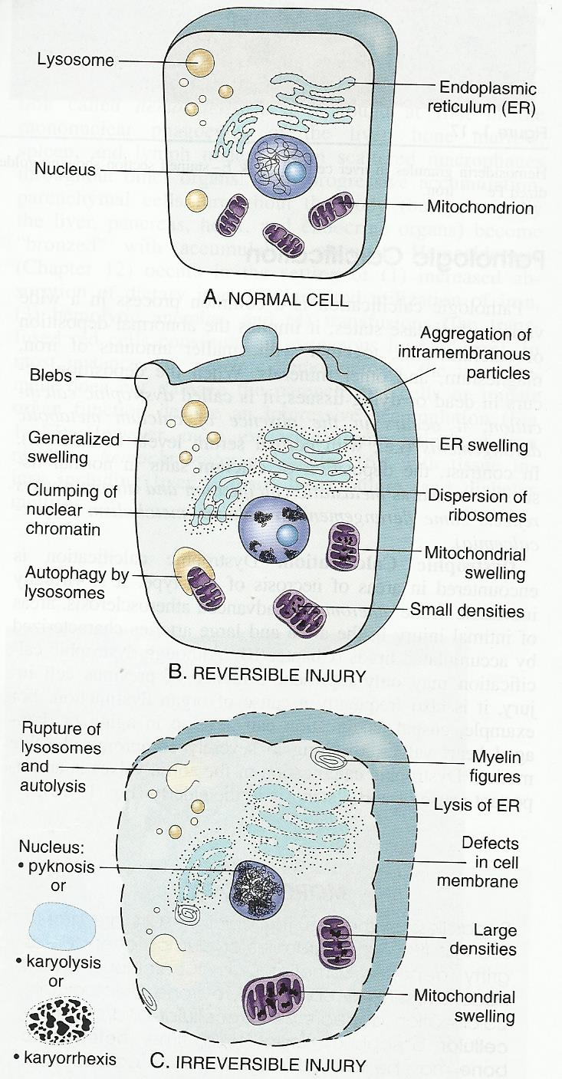
Schematic representation of the ultrastructural features of a normal cells (A) and those changes seen in reversible (B), and irreversible (C), cell injury.

Slide 82
CELLULAR INJURIES
Irreversible cellular injuries or cell death
In irreversible cellular damage, the pathological change has advanced to a stage that is permanent and will lead to cell death.
There are two types of cell death:
1. Necrosis and
2. Apoptosis.

Slide 83
NECROSIS
NECROSIS
Necrosis is cell death or irreversible cellular injury.
They are changes produced by enzymatic digestion of dead cellular elements.
Necrosis is the most common form of cell death.
It describes the process of cell death due to external stimulus.
It occurs as a consequent to irreversible cell injury leading to cell death.
It is always associated with an inflammatory process.

Slide 84
NECROSIS
Cells such as neutrophils, macrophages e.t.c. are present when observed under the microscope.
For necrosis to take place, there is disintegration of vital functions of the cells, tissues organs beyond a reversible state.
Whether anatomically or functionally, necrosis is recognizable.

Slide 85
NECROSIS
Functional identification of necrosis
This is associated with analysis of the product particularly lytic enzyme released from cellular cytoplasmic contents.
This enzyme acts as a biochemical index of cell death.
Morphologically, necrosis is represented from the naked eye inspection by whitish discoloration of the affected area followed by a yellowish discoloration and softening which is synonymous with when the lytic enzyme comes into play.

Slide 86
NECROSIS
Patterns of necrosis in tissues or organs
As a result of cell death, the tissues or organs display certain macroscopic changes.
Coagulative necrosis:
This is the most common pattern in necrosis.
It occurs in almost all organs, outline of dead cells are maintained and the tissue is firm.

Slide 87
NECROSIS
Liquifactive (colliquative) necrosis
The dead cells undergo disintegration and the affected tissue is liquefied, this results in action of powerful hydrolytic enzymes, example is cerebral infarction.
It also occurs as a result of bacteria or fungi infection and it involves complete breakdown and digestion of the dead cell.

Slide 88
NECROSIS
Caseous necosis:
It is a form of coagulative necrosis, it is found typically in the center of tuberculotic lesion
grossly the necrotic area appears soft and white resembling cheese material and therefore is called cheese-like necrosis.
Gangrenous necrosis:
It is typically secondary to ischaemia and superimposed infection
eg necrosis of distal limbs usually foot and toes in diabetics.

Slide 89
NECROSIS
Fat necrosis:
This is encountered in adipose tissues due to the action of lipases.
It is most commonly seen in acute pancreatic necrosis in which pancreatic enzymes cause fatty deposit throughout the abdomen.

Slide 90
NECROSIS
Morphology of necrosis
Cytoplasmic organelles:The digestive action of enzymes may show breakdown of membrane walls or organelles especially endoplasmic reticulum.
Nuclear changes: The nucleus exhibits changes in the chromatin material.

Slide 91
NECROSIS
Nuclear Changes:
Pyknosis:
The nucleus progressively shrinks and becomes transformed to a dense and small wrinkled mass of chromatin
Karyolysis:
Chromatin undergoes progressive dissolution and eventually disappears
Karyorrhexis:
This is fragmentation of chromatin which occurs by mitosis.
The nucleus of a dead cell completely disappears in 1 to 2 days.

Slide 92
APOPTOSIS
APOPTOSIS:
Apoptosis is a programmed cell death.
It is a vital process that helps to eliminate unwanted cells.
It is an internally programmed series of events affected by dedicated gene products.
There are instances that certain cells are needed only for a short period of time and then regarded as useless or detrimental to the process involved.
Thus they indulge themselves in a suicide programme causing minimal injury to the surrounding tissues.

Slide 93
APOPTOSIS
Apoptosis serves several vital functions and is seen under various settings as follows:
During development for removal of excess cells during embryogenesis.
To maintain cell population in tissues with high turnover of cells such as skin, bowels etc.
To eliminate immune cells after cytokine depletion and auto reactive T cells in developing thymus.

Slide 94
APOPTOSIS
To remove damaged cells by viruses
To eliminate cells with DNA damage by radiation, cytotoxic agents etc.
Hormone dependent involution e.g. ovary endometrum, breast
Cell death in tumours

Slide 95
APOPTOSIS
Morphology of apoptosis
Shrinkage of cells
Condensation of nuclear chromatin peripherally under nuclear membrane
Formation of apoptotic bodies by fragmentation of the cells and nuclei
Phagocytosis of apoptotic bodies by adjacent healthy cells or phagocytes
N/B
Unlike necrosis, apoptosis is not accompanied by inflammation reaction thus hindering microscopic recognition.

Slide 96
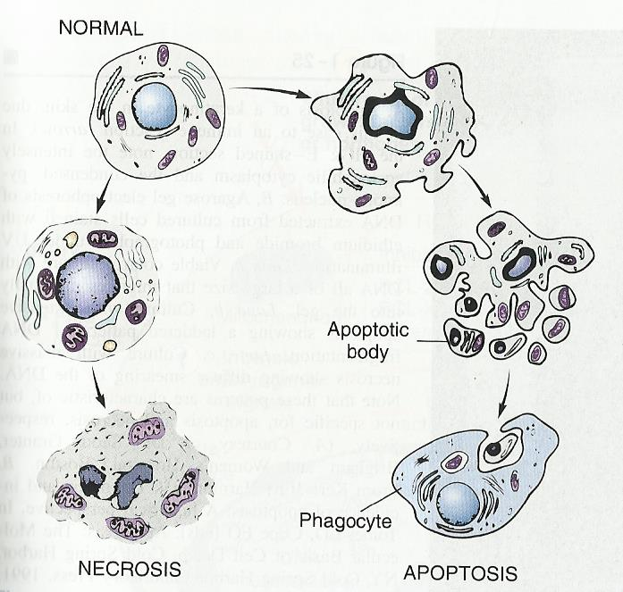
APOPTOSIS

Slide 97
SOMATIC DEATH
SOMATIC DEATH
Somatic death is the death of the body as a whole.
It occurs when respiration and heart activity stop. (Cessation of breathing and cardiac arrest) although individual cells and even tissues may continue to live for short periods.
Soon, characteristic changes begin to make their appearance in the dead bodies.

Slide 98
SOMATIC DEATH
Signs of somatic death
Cessation of breathing
Cardiac arrest (no pulse)
Loss of response to stimuli
Cessation of the circulation
Pallor mortis : Paleness which happens in the 15–120 minutes after death
Algor mortis : This is the reduction in body temperature following death.
This is generally a steady decline until matching ambient temperature

Slide 99
SOMATIC DEATH
Livor mortis : This is a reddish discoloration of the dependent parts of the body due to the sinking of the blood from gravity, combined with a breaking down (haemolysis) of the red blood cells.
Rigor mortis: This is muscular rigidity due to chemical changes in the muscle. The stiffness begins in 4 hours or more and passes off in 3 days. The limbs of the corpse become stiff and difficult to move or manipulate
Decomposition : This is reduction into simpler forms of matter, accompanied by a strong, unpleasant odor.

Slide 100
CELLULAR ADAPTION TO INJURY
As cells encounter physiologic stress, or pathologic stimuli, they undergo adaptation, achieving a new steady state and preserving viability.
The principal adaptive responses are:
Atrophy
Hypertrophy
Hyperplasia
Metaplasia
Dysplasia

Slide 101
CELLULAR ADAPTION TO INJURY
If the adaptive capability is exceeded cell injury develops.
These physiological adaptations usually represent responses of cells to normal stimulation by hormones or endogenous chemical mediators e.g the enlargement of the breast and induction of lactation and pregnancy.
Pathologic adaptation often shares the same underlining mechanisms but they allow the cells modulate their environment and ideally escape injury.
Thus cellular adaptation is a state that lies between the normal unstressed cell and the injured overstressed cell.

Slide 102
CELLULAR ADAPTION TO INJURY
ATROPHY
Shrinkage in the size of the cell by the loss of cell substance,
When a sufficient number of cells are involved, the entire tissue or organ diminishes in size becoming atrophic.
Although atrophic cells may have diminished function, they are not dead.
Atrophy represents a retreat by the cell to a smaller size at which survival is still possible.
A new equilibrium is achieved between cell size and diminished blood supply, nutrition and trophic stimulation.

Slide 103
CELLULAR ADAPTION TO INJURY
Causes of atrophy
Decreased workload e.g immobilization of a limb to permit healing of a fracture
Loss of innervations
Diminished blood supply
Inadequate nutrition
Loss of endocrine stimulation
Ageing

Slide 104
CELLULAR ADAPTION TO INJURY
Physiologic atrophy
Morphologically by naked eye inspection, atrophy is seen as reduction in size of an organ.
e.g a normal adult heart that is supposed to weigh 250-350g, when it undergoes atrophic changes can weigh as little as 100g.
Most physiologic atrophies are related to age, with advancement in age, there is reduction in physiologic activities.

Slide 105
CELLULAR ADAPTION TO INJURY
The cells and tissues undergo degenerative changes.
Examples of physiological atrophy are:
(1) Cardiac atrophy
(2) Testicular atrophy
(3) Atrophy of the uterus and ovary during menopause due to loss of endocrine stimulation
(4) Physiologic atrophy of the breast.

Slide 106
CELLULAR ADAPTION TO INJURY
Pathologic atrophy
These are particularly resulting from diseased entities that include:-
Neoplastic conditions, particularly malignant neoplasia (cancer)
Immobilization and sedentary activities
Inability of the body’s regulation of hormonal system.

Slide 107
CELLULAR ADAPTION TO INJURY
Neoplastic condition:
In the case of neoplasia (cancer), atrophy results from general disbalance or disorganization of organs by the activities of stubborn uncontrollable cells that are proliferating and multiplying.
Each system is unable to carry out its function and this result in a multiple organ failure and the overall effect is known as a state of CACHEXIA

Slide 108
CELLULAR ADAPTION TO INJURY
Atrophy resulting from immobilization and sedentary activities:
This can be best seen with people with bone fracture because of their inability to utilize their skeletal muscle.
The skeletal muscle undergoes progressive reduction in size i.e decreased work load.
Sometimes this type of atrophy can result in excessive compression of a large organ from its neighbour
e.g a uterus with fibroid can cause pressure atrophy changes in the bladder and large intestine.

Slide 109
CELLULAR ADAPTION TO INJURY
Inability of the body’s regulation of hormonal system.
Atrophy in the last stage can result in the improper regulation or hormonal imbalance in which the target organ adapts itself by reduction in size
e.g. when there is an imbalance between progesterone and estrogen, some women react by having atrophy of both ovaries.

Slide 110
CELLULAR ADAPTION TO INJURY
HYPERTROPHY
This means increase in the size of the cell and consequently an increase in the size of the organ.
In pure hypertrophy there are no new cells just bigger cells enlarged by increased synthesis of structural protein and organelles.
Hypertrophy can be caused by:
Increase functional demand
Specific hormonal stimulation

Slide 111
CELLULAR ADAPTION TO INJURY
Hypertrophy can be physiologic or pathologic
Physiologic hypertrophy:
It results from conditions that demand increase in metabolic activity of tissues and organs and sometimes to over reaction to some types of hormonal production
e.g skeletal muscle reaction to excessive exercise by an increase in oxygen consumption for their metabolic processes.
In such condition, there is an excessive muscular hypertrophy

Slide 112
CELLULAR ADAPTION TO INJURY
eg the weight lifters can develop their rippled physique only by hypertrophy of individual skeletal muscle induced by an increased workload.
Another example is the massive hypertrophy of the uterus during pregnancy which occurs as a consequence of estrogen stimulation.

Slide 113
CELLULAR ADAPTION TO INJURY
Pathologic hypertrophy
An example of pathologic hypertrophy is seen in cardiac enlargement that occurs with hypertension or aortic valve disease.
The heart which must contract against increased pressure achieves a weight of about 700 – 1000g.
Another example is enlargement of residual viable cardiac myocytes after myocardial infarction.
In this case, hypertrophy compensate for death of neighbouring cells due to ischaemia.

Slide 114
CELLULAR ADAPTION TO INJURY
In some conditions in which there is imbalance of hormonal functions with advancement of age, some target organs respond by increase in size
e.g. an imbalance between estrogen and testosterone causes benign hypertrophy of the prostate.

Slide 115
CELLULAR ADAPTION TO INJURY
Hyperplasia
It constitutes an increase in the number of cells in an organ or tissue.
Hypertrophy and hyperplasia are closely related and often develop concurrently in tissues so that both may contribute to an overall increase in organ size
e.g. the gravid uterus (pregnant uterus).
Hyperplasia can be pathologic or physiologic.

Slide 116
CELLULAR ADAPTION TO INJURY
Physiologic hyperplasia
Hormonal hyperplasia:
This is exemplified by the proliferation of the glandular epithelium of the female breast at puberty and during pregnancy.
Compensatory hyperplasia:
This is hyperplasia that occurs when a portion of the tissue is removed or diseased
e.g. when a liver is partially resected, mitotic activity in the remaining cells begin as early as 12 hrs later eventually restoring the liver to its original state.

Slide 117
CELLULAR ADAPTION TO INJURY
Pathologic hyperplasia
Most forms of pathologic hyperplasia are instances of excessive hormonal stimulation or the effect of growth factor on target cells.
Hyperplasia of the endometrum is an example of hormonally induced hyperplasia.
If the balance between estrogen and progesterone is disturbed resulting in excess of estrogen, hyperplasia of endometrium may result.
The patient presents with abnormal uterine bleeding.

Slide 118
CELLULAR ADAPTION TO INJURY
Endometrial hyperplasia is considered a forerunner of endometrial carcinoma.
Pathologic hyperplasia constitutes a fertile soil in which cancerous proliferation may eventually arise,
Thus patients with hyperplasia of the endometrium are at increased risk of developing endometrial cancer.

Slide 119
CELLULAR ADAPTION TO INJURY
Metaplasia
This is cellular adaptation whereby cells sensitive to a particular stress are replaced by other cell types better able to withstand the adverse environment.
Epithelial metaplasia is exemplified by the squamous change that occurs in the respiratory epithelium of habitual cigarette smokers.
The normal ciliated, columnar epithelia cells of the trachea and bronchi are focally or widely replaced by stratified squamous epithelia cells.

Slide 120
CELLULAR ADAPTION TO INJURY
Vitamin A deficiency may also induce squamous metaplasia in the respiratory epithelium.
Presumably, the more rugged stratified squamous epithelium is able to survive under circumstances that the more fragile specialized epithelium would not tolerate.

Slide 121
CELLULAR ADAPTION TO INJURY
Dysplasia:
The term refers to either epithelial or mesenchymal cells that have undergone proliferation and a typical cytogenic cell alterations involving cell size, shape and organization.
The dysplastic cells are characterized by increased mitotic activities.
It is considered a forerunner of cancer.

Slide 122
INFLAMMATION
Inflammation is a complex reaction in vascularized connective tissue as a result of cell injury.
It is a protective response intended to eliminate the initial cause of cell injury as well as necrotic cells and tissues resulting in the original insult.
Inflammation accomplishes its protective mission by diluting, destroying or otherwise neutralizing harmful agents e.g microbes or toxins.
It then sets into motion the events that eventually heal and reconstitute the site of injury

Slide 123
INFLAMMATION
Inflammation is a generic response, and therefore it is considered as a mechanism of innate immunity.

Slide 124
INFLAMMATION
The inflammatory responses has many components, these include:
Circulating cells: These are bone marrow derived polymorphonuclei leucocytes (neutrophils), monocytes, eosinophils, lymphocytes, basophils and platelets.
Circulating proteins: This includes clotting factors, kininogenes and complement components largely synthesized by the liver.
Vascular Wall Cells: This includes endothelial cells in direct contact with the blood as well as the underlining smooth muscle cells that impart tone to the vessels.

Slide 125
INFLAMMATION
Connective tissue Cells: This includes mast cells, macrophages, lymphocytes and fibroblasts.
Extracellular Matrix: This includes fibrous structural protein e.g collagen and elastin, gel forming proteoglycans and adhesive glycol proteins

Slide 126
INFLAMMATION
There are two types of inflammation,
Acute and
Chronic inflammation.
Acute inflammation is of relatively short duration lasting from a few minutes up to a few days.
It is characterized by fluid, plasma protein extrusion.
Sources of acute inflammation include infection (bacteria, viral, parasitic) and microbial toxins.

Slide 127
INFLAMMATION
Chronic inflammation is of a longer duration (days to years).
It is typified by influx of mononuclear cells, lymphocytes, macrophages and plasma cells with associated vascular proliferation and scaring.
Causes include viral infections, chronic infections,
Persistent injury and autoimmune response.

Slide 128
INFLAMMATION
Both acute and chronic inflammation can overlap

Slide 129
ACUTE INFLAMMATION
This is the immediate and early response to injury, designed to deliver leukocytes to site of injury.
Acute inflammation has two major components:-
Vascular changes and
Cellular events

Slide 130
ACUTE INFLAMMATION
Vascular changes:-
Vasodilatation and increased vascular permeability.
Alterations in vessel caliber that results in increased blood flow and
Structural changes that permit plasma protein to leave the circulation

Slide 131
ACUTE INFLAMMATION
These cascade of events in acute inflammation is integrated by local release of chemical mediators.
Chemical mediators of inflammation
Local mediators:- Vasoactive amines e.g.
(a) Histamine:- It is widely distributed in tissues particularly mast cells, also present in circulating basophils and platelets.
Histamine causes arteriolar dilatation and is the principal mediator of the immediate phase of increased vascular permeability.

Slide 132
ACUTE INFLAMMATION
(b) Serotonin: It has effects similar to histamine and found primarily within platelets.
(c) Lysosomal Enzymes:- This includes prostaglandins, nitric oxide, cytokines.

Slide 133
ACUTE INFLAMMATION
Systemic mediators:-
(1) Kinin System: e.g. Bradykinin.
Like histamine, Bradykinin causes increased vascular permeability, arteriolar dilatation and bronchial smooth muscle dilatation.
(2) Coagulation/fibrinolysis system
(3) Anaphylatoxins
(4) Membrane attack complex

Slide 134
ACUTE INFLAMMATION
(2) Cellular events:-
(a) Cellular recruitments and – emigration of leucocytes from the microcirculation and accumulation in the site of injury.
(b) Cellular activation
margination
adhesion – chemotaxis and
activation.

Slide 135
ACUTE INFLAMMATION
Phases of acute inflammation
Generally, acute inflammatory pathways consist of a number of inter-dependent phases:-
(1) Alternative phase
(2) Exudation phase
(3) Reparative phase

Slide 136
ACUTE INFLAMMATION
Alternative phase:
This phase of inflammatory process includes the tissue reaction which occurs in the interval between injury and appearance of exudative phase.
The phase is of short duration and almost not clinically and directly observable.
The tissue changes which occur are retrogressive in nature.

Slide 137
ACUTE INFLAMMATION
As a result of these tissue changes, certain chemical substances are released into the injured area and this includes vaso active amines, polypeptides etc.
The chemical substances alter the hydrogen ion concentration and the osmolarity of microcirculation and act directly on the microcirculation to initiate the exudative phase of the inflammatory process.

Slide 138
ACUTE INFLAMMATION
Exudative phase:
This is a vascular reaction characterized by the formation of an exudate which is a protein rich fluid of high specific gravity.
The fluid that is initially formed during this type of reaction contains a little number of cells and almost completely lacks proteins and is referred to as transudate.

Slide 139
ACUTE INFLAMMATION
The exudative phase is responsible for the five (5) cardinal signs of acute inflammation.
Four (4) cardinal (macroscopic signs) signs of acute inflammation were described by Celsius.
Galen actually added the 5th sign which is loss of function.

Slide 140
ACUTE INFLAMMATION
Rubor - Redness
Calor - Heat
Dolor - Pain
Tumour - Swelling
Function laese - Loss of function

Slide 141
ACUTE INFLAMMATION
Redness (Rubor): This is a central dull area at the site of injury as a result of dilatation of vessels (venules and capillaries) which were acted on directly by chemical substances released in the area
Bright red halo surrounding the site of injury and dilatation of arteriole outside the injured area are observable.

Slide 142
ACUTE INFLAMMATION
Heat (Calor):
The vascular dilatation is associated with increased rate of flow and volume of blood into the injured area.
The injured area when on the exposed body surface is at lower temperature than the interior of the body in which the blood flows, thus the tissue in the injured area becomes warmer than the adjacent areas.

Slide 143
ACUTE INFLAMMATION
Pain (Dolor):
This probably results from a combination of factors acting alone or together on nerve endings in the injured area.
Some of these factors are pressure caused by the exudates in the tissue, released serotonin and of bradykinin into the tissue and altered tonicity and osmolarity.

Slide 144
ACUTE INFLAMMATION
Swelling (Tumour):
Swelling of the injured area is due to accumulation of exudates in the injured tissue.
Increased vascular permeability is the basis for the exudates.
The increased vascular permeability allows initially fluids and colloids and later cells from the lumen of the microcirculation to enter into the interstitial compartments.

Slide 145
ACUTE INFLAMMATION
Loss of function (Function laese):
Decreased function of inflamed area is usually caused by a reflex inhibition of muscle movement associated with pain and mechanical disability produced by swelling.

Slide 146
ACUTE INFLAMMATION
Functions of exudate
To limit the extent of tissue damage
It helps to dilute the toxins in the tissue

Slide 147
ACUTE INFLAMMATION
Effects of inflammation and their major mediators:-
1. Vasodilatation
2. Vascular permeability
3. Chemotaxis
4. Fever
5. Pain, Tissue damage

Slide 148
ACUTE INFLAMMATION
Systemic effects of inflammation
1. Fever (pyrexia) – high temperature
2. Malaise – general feeling of illness
3. Anorexia – loss of appetite
4. Somnolence – feeling sleepy
5. Leukocytosis – increased white blood cell.

Slide 149
ACUTE INFLAMMATION
Outcome of acute inflammation
Although the consequences of acute inflammation are modified by the nature and intensity of the injury, the site and tissue affected and the ability of the host to mount a response,
acute inflammation generally has three (3) outcomes:

Slide 150
ACUTE INFLAMMATION
Resolution: This involves neutralization or removal of chemical mediators.
Neutralization of vascular permeability and cessation of leukocytes emigration with subsequent death of estravasated neutrophils.
Thus there is restoration of histologic and functional normalcy.
Resolution results from limited or short lived injury with minimal tissue damage.

Slide 151
ACUTE INFLAMMATION
Scarring or Fibrosis:
This results from injuries with substantial tissue destruction or when inflammation occurs in tissues that do not regenerate.
Due to extensive underlying tissue destruction, the only outcome is scarring.

Slide 152
ACUTE INFLAMMATION
Progression to chronic inflammation
This may follow acute inflammation, although the signs of chronic inflammation may be present at the onset of injury.
Chronic inflammation may be followed by regeneration of normal structure and function but may lead to scarring.

Slide 153
ACUTE INFLAMMATION
Clinical information about inflammation
Clinically inflammation is represented by the nomenclature “ITIS” but at other times some traditional nomenclature are used e.g. pneumonia
Acute inflammation occurs generally in tissues that are well vascularized and they present with fever and pain.
Chemical reactions and their product can be investigated either by the study of the blood or tissue exudate.

Slide 154
ACUTE INFLAMMATION
Reparative Phase: Repair begins almost as soon as the inflammatory changes have started and involves several processes including cell proliferation, cell differentiation and extra cellular matrix deposition.
Repair involves two main processes
Regeneration of injured tissue by parenchyma cells of the same type.
Replacement by connective tissue (fibrosis) resulting in a scar.
Commonly tissue repair (healing) involves a combination of both processes.

Slide 155
ACUTE INFLAMMATION
Regeneration of injured tissue by parenchyma cells of the same type :
The cells of the body are divided into 3 groups on the basis of their regenerative capacities and their relationship to the cell cycle.
Labile cells:These are continuously dividing and continuously dying cells e.g. heamatopoetic cells in the bone marrow and majority of surface epithelia cells including the stratified squamous epithelia of the skin, columnar epithelia of GIT, uterus etc.

Slide 156
ACUTE INFLAMMATION
Stable cells : These have low level replicating capacity in their normal state but are capable of undergoing rapid division in response with injury
e.g. parenchyma of most solid glandular tissues including liver, kidney, pancreas as well as endothelia cells lining blood vessels.
Permanent cells: These are considered to be terminally differentiated and non-proliferative in post natal life.
neurons and cardiac muscles cells belong to this category.
Thus, injury to brain or heart is irreversible and results to only scar formation since the tissue cannot proliferate.

Slide 157
ACUTE INFLAMMATION
Cell growth and differentiation are dependent on extra cellular signals derived from :
(a)Soluble chemical mediators e.g. polypeptide growth factor circulating in the serum or produced locally by cells.
(b)Extra cellular matrix (ECM)
Component of ECM:-
Fibrous structural proteins that confer tensile strength e.g. collagen and elastin.
Water hydrated gel that enhance lubrication e.g. proteoglycans
Adhesive glycoprotein that connect the matrix element onto one another and to other cells e.g. fibrorectin and laminin

Slide 158
ACUTE INFLAMMATION
Replacement by connective tissue:
Severe or persistent tissue injury with damage to both the parenchyma cells and to the stroma frame work leads to a situation in which repair cannot be accomplished by parenchyma regeneration alone.
Under these conditions repair occurs by replacement of the non-regenerated parenchyma cells with connective tissue

Slide 159
ACUTE INFLAMMATION
There are 4 general components of this process:
Formation of new blood vessels (Angiogenesis)
Migration and proliferation of fibroblasts
Deposition of Extra Cellular Matrix (ECM)
Maturation and reorganization of the fibrous tissue (remodeling)

Slide 160
WOUND HEALING
Wound healing is a complex but generally orderly process.
The events are orchestrated by interplay of soluble growth factors and extracellular matrix (ECM) and physical factors.
Wound healing is regarded as the basis for all surgical procedure.

Slide 161
WOUND HEALING
Types or forms of wound healing
(1) Healing by 1st intention or primary union
e.g. is a healing of a clean uninfected surgical incision approximated by surgical sutures.
Epithelial regeneration predominates over fibrosis in this form of healing.
The narrow incisional phase rapidly fills with fibrin clothed blood.
The hydration at the surface produces a scab to cover and protect the healing repair site.
The final product is a clean and organized tissue.

Slide 162
WOUND HEALING
Healing by secondary intention:-
This form of healing occurs when cells or tissue loss is more extensive as in infarction, inflammatory, ulcerative, and abscess formation of large wounds.
It involves a more complex reparative process.
Restoration of parenchyma cells alone cannot restore the original cell architecture as a result, there is an extensive in growth of granulation tissue from the wound margin, followed by accumulation of ECM and scarring.

Slide 163
WOUND HEALING
Factors that affect wound healing
Local factors
Blood supply:
A good blood supply gives rise to good wound healing
Superimposed infection:-
This gives rise to poor wound healing.
Infection prolongs the inflammation phase of healing process and potentially increases the local tissue injury.
Presence of foreign body
eg fragments of steel, glass or bone, this gives rise to poor wound healing as they impede the healing process.

Slide 164
WOUND HEALING
Mobility of tissues:
A well mobilized tissue heals faster than immobilized tissue.
(e)Type of tissue
(complete repair can only be seen in labile and stable cells).
Injury to tissues composed of permanent cells must inevitably result in scarring.
Such is the case with the healing of myocardial infarction.

Slide 165
WOUND HEALING
Systemic factors
1). Nutritional factors:
poor nutritional status will give rise to a poor wound healing.
Protein deficiency and particularly Vit. C deficiency inhibits collagen synthesis and retard healing.
2). Physiological conditions:
Physiological conditions of individuals in particular immunological status – Immunodeficient individual of primary or acquired nature have poor wound healing.
3). Aging process:
Healing is faster in children than in adult
4). Endocrine deficiency:
Reduction in most endocrine secretions gives rise to poor wound healing
e.g. deficiency of adrenal gland in the production of ACTH gives rise to poor wound healing.

Slide 166
WOUND HEALING
Complications of wound healing
(1) Keloid formation: This is an abnormal formation of healing particularly found in negroid race.
There is accumulation of exuberant amounts of collagen which can give rise to prominent raised scars known as keloid.
(2) Hypertrophic tissue: This is an abnormal production of extra strengthened collagen fibre.

Slide 167
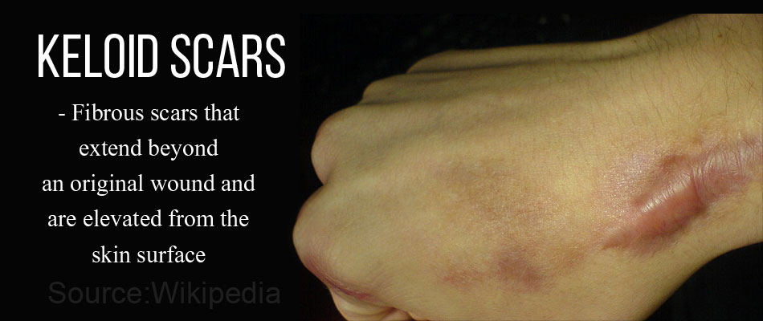
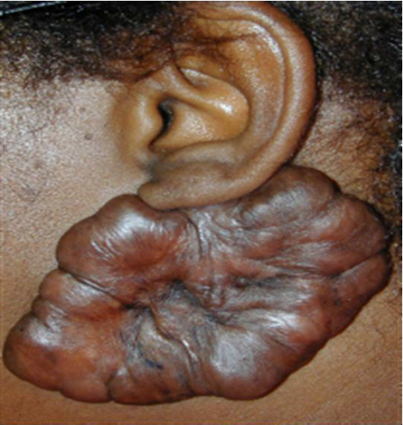
WOUND HEALING
Keloid

Slide 168
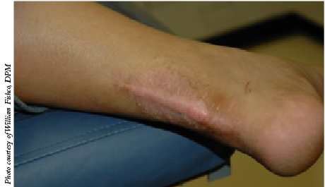
WOUND HEALING
Hypertrophic tissue

Slide 169
WOUND HEALING
(3) Exuberant granulation (proud tissue):
This is where a healing wound generates excessive granulation tissue that protrudes above the level of the surrounding skin.
They contain few vascular tissues, chronic inflammatory cells and collagen fibres.
The outgrowth of new capillaries and connective tissue cells from the surface of an open wound is called a granulation tissue.

Slide 170
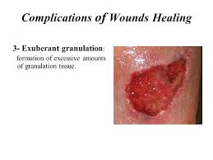
WOUND HEALING
Exuberant granulation (proud tissue)

Slide 171
CHRONIC INFLAMMATION
Chronic inflammation can be considered to be inflammation of prolonged duration of (weeks to months, years) in which active inflammation, tissue injury and healing proceed simultaneously.
Chronic inflammation is characterized by
(1) Infiltration of mononuclear cells (macrophages, lymphocytes and plasma cells).
(2) Tissue destruction – largely directed by inflammatory cells.
(3) Repair involving new vessel proliferation and fibrosis.

Slide 172
CHRONIC INFLAMMATION
Chronic inflammation arises in the following settings.
Viral infections
Persistent microbial infections
Prolonged exposure to potential toxic agent
Auto immune disease e.g. rheumatoid arthritis

Slide 173
CHRONIC INFLAMMATION
Chronic inflammation may progress from acute inflammation.
If the condition causing acute inflammation is not resolved, the inflammation may pass to a longer term chronic phase.
Also, some pathogens by their nature tend to directly provoke chronic rather than acute inflammation.
Many of the features of acute inflammation continue as the inflammation becomes chronic, including increased blood flow and increased capillary permeability.
Accumulation of white blood cells also continues, but the composition of the cells changes.

Slide 174
CHRONIC INFLAMMATION
Neutrophils quickly enter the infected tissue, and these short-lived cells predominate initially.
However,soon macrophages and lymphocytes
begin to be recruited.
Thus, the primary cells of chronic inflammation are macrophages and lymphocytes.

Slide 175
CHRONIC INFLAMMATION
Chronic inflammation is distinguished from acute inflammation by the absence of cardinal signs such as:
Rubor, calor, dolor, tumor, active hyperemia, fluid exudation and neutrophilic emigration.
It is distinguished from acute inflammation by its long duration, which permits a manifestation of immune response.

Slide 176
CHRONIC INFLAMMATION
Histologic Hallmarks of chronic inflammation are:
1. Infiltration of affected tissue by macrophages, lymphocytes and plasma cells
2. Proliferation of fibroblasts and myofibroblasts and proliferation of small blood vessels, together known as formation of granulation tissue
3. Most cases of chronic inflammation are accompanied by an increase in amount of connective tissue, referred to as fibrosis, or production of scar

Slide 177
CHRONIC INFLAMMATION
Types of chronic inflammation
Chronic specific or non specific reactions
A chronic specific reaction is usually associated with known cause or isolated micro organism e.g. chronic peptic ulcer.
It sometimes overlaps into chronic granulomatous reaction.
Non specific chronic reaction is caused by organisms that are usually multiple, and specific organisms are impossible to be isolated or demonstrated.

Slide 178
CHRONIC INFLAMMATION
Chronic granulomatous inflammatory reaction
Granulomatous inflammation is a distinct type of chronic inflammation.
It is marked by the formation of granulomas
which are small collections of modified macrophages called epithelioid cells and are usually surrounded by lymphocytes.
Granulomas often contain giant, or Langerhan cells that form the coalescence of epithelioid cells.
A classic example of granulomatous inflammation is tuberculosis, and the granulomas formed are called tubercles.

Slide 179
CHRONIC INFLAMMATION
Granulomas also typically arise from fungal infections, and they are present in schistosomiasis, syphilis, and rheumatoid arthritis.
Granuloma formation does not always lead to eradication of the causal agent which is frequently resistant to killing or degradation but effectively “wall off” the offending agent and is therefore a useful defense mechanism.
According to the mechanism, granulomatous inflammation may be:
Immune type (tuberculosis, sarcoidosis) and
Non immune type (foreign body reaction).

Slide 180
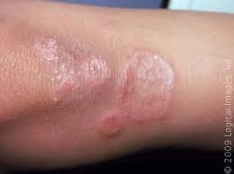
CHRONIC INFLAMMATION
granuloma

Slide 181
MORPHOLOGIC PATTERNS OF ACUTE AND CHRONIC INFLAMMATION
The severity of the inflammatory response, its specific cause and the particular tissue involved can all modify the basic morphologic patterns of acute and chronic inflammation.
Such patterns frequently have clinical significance.

Slide 182
MORPHOLOGIC PATTERNS OF ACUTE AND CHRONIC INFLAMMATION
Morphology
Serous inflammation
This is characterized by the outpouring of a watery relatively protein poor fluid called EFFUSION.
This effusion depending on the site of the injury could be from the serum or from the secretions of cells lining the peritoneal, pleural and pericardial cavities.
A good example of serous effusion is the skin blister resulting from a burn or viral infection

Slide 183
MORPHOLOGIC PATTERNS OF ACUTE AND CHRONIC INFLAMMATION
Fibrinous inflammation
This occurs as a result of more severe injuries with a resultant greater vascular permeability allowing larger molecules (specifically fibrinogens) to pass the endothelial barriers.
Fibrinous exudates may be degraded by fibrinolysis and the accumulated debris may be removed by macrophages resulting in restoration of the normal tissue structure.
It may also result in the growth of fibroblasts and blood vessels leading to scarring if not completely removed.

Slide 184
MORPHOLOGIC PATTERNS OF ACUTE AND CHRONIC INFLAMMATION
Suppurative (purulent) inflammation
This is manifested by the presence of large amounts of purulent exudates (pus) consisting of neutrophils, necrotic cells and edema fluid.
Certain organisms eg staphylococcus are more likely to induce this localized suppuration and therefore referred to as pyogenic organisms. Focal collections of pus are called abscess.

Slide 185
MORPHOLOGIC PATTERNS OF ACUTE AND CHRONIC INFLAMMATION
Ulcerative inflammation
This refers to a site of inflammation where an epithelial surface has been necrotic and eroded often with associated sub epithelial acute and chronic inflammation.
This can occur as a result of toxic or traumatic injury to the epithelial surface.

Slide 186
ONCOLOGY
Oncology
The branch of medical science dealing with tumors, including the origin, development, diagnosis, and treatment of malignant neoplasms.

Slide 187
NEOPLASIA
Neoplasm
This is abnormal new, uncontrolled growth of cells that is not under physiologic control.
A "tumor" or "mass lesion" is simply a "growth" or "enlargement" which may not be neoplastic.
Eg : A granuloma.
Some neoplasms do not form a tumor eg leukemia and most forms of carcinoma in situ.

Slide 188
NEOPLASIA
Origin of neoplasm
The origin of tumour is from abnormal and excessive proliferation of a cell derived from the previously normal tissue.
Tumours arise mostly from tissues in which the cells are labile (e.g epithelial cells).
Many tumours do however originate from the cells of organs not so exposed and normally having more stable cells
e.g those of the liver, thyroid gland, adrenal glands e.t.c.

Slide 189
NEOPLASIA
Causes of neoplasia
This can be divided into two :-
Endogeneous causes
Exogenous causes (Acquired)

Slide 190
NEOPLASIA
ENDOGENEOUS CAUSES
(i). Genetic/hereditary factors
All genes capable of inducing neoplasia are called oncogenes.
All normal cells of the body contain proto-oncogenes for their normal physiological functions.
Studies have shown that proto-oncogens under certain conditions ( mutations and increased expression) can be transformed into oncogene.
The current concepts of all tumours is based on their genetic origin

Slide 191
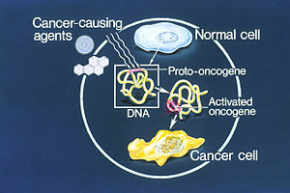
NEOPLASIA

Slide 192
NEOPLASIA
Hormones
The concept that hormones can cause, i.e., increase the incidence of, human cancer is most developed for the four hormone-related cancers:
Breast, prostate, endometrial, and ovarian cancers.
These are numerically the most important.

Slide 193
NEOPLASIA
Chronic disease
Chronic inflammatory conditions are associated with neoplastic conditions.
Chronic irritation of the cervix, skin and post infection reactions have been found to be associated with neoplastic changes of the affected tissues.

Slide 194
NEOPLASIA
EXOGENEOUS CAUSES (ACQUIRED)
The complexities of genetic and environmental factors and of their interactions accounts for many of the difficulties of the epidemiological and experimental investigations of causes of cancer.
There is a great variation in the intensity and length of exposure to individual carcinogen.

Slide 195
NEOPLASIA
Physical Agents
(a) Ionizing radiations (x-rays): therapeutic radioactive waves have been associated with the cancer of blood and bone amongst X-ray workers, radiotherapists and people in area where there have been nuclear fallouts.
(b) ultra-violet radiations: UV radiation from the sun has been observed to cause multiple squamous carcinoma, basal cell carcinoma and malignant melanoma of the skin.

Slide 196
NEOPLASIA
Chemical agents and drugs
Three types of chemicals have been relatively studied in relation to the origin or causes of neoplasia in animals and man.
These include:
1.Polycyclic Aromatic Hydrocarbons (PAHs)
products of combustion in cigarette smoke, diesel exhaust (diesel-fueled engines), grilled meats, coal, oil, petrol, etc

Slide 197
NEOPLASIA
2. Amines
Some aromatic amines used in
rubber and cable production,
pigment and paint manufacturing,
textile and laboratories
printing
cause cancer of the bladder amongst these workers.
3. Azo compounds. (Azodynes) :Used in food colouration eg scarlet red, butter yellow etc

Slide 198
NEOPLASIA
Medicinal drugs
Among medicinal drugs diethyl stibesterol (stops lactation in women) has been shown to produce cancer of the cervix among the offsprings of mothers who have used it to stop lactation.
Viral agent
A few viruses have been proven to be oncogenic E.g. Human Papilloma Virus (HPV), Hepatitis B and C

Slide 199
NEOPLASIA
Diet
Genetically modified (GMO) foods
Chemical toxins in food manufacturing industries.

Slide 200
NEOPLASIA
Classification of tumours
Basically tumours are classified in two ways:
By their biologic behaviour
By their tissue of origin ( Histogenesis)
CLASSIFICATION ACCORDING TO THEIR BIOLOGIC BEHAVIOUR
Tumours are broadly classified into two:
(a) Benign (b) Malignant.
This classification is based on the biological behaviour of the neoplastic forming cell.

Slide 201
NEOPLASIA
A benign neoplasia has the following characteristics:
behaves and resembles the tissue of origin.
Its growth is regulated by the proteinous substances that it gives out.
It does not invade the neighboring tissues
the cellular components constituting benign growth have normal morphologic features.
There is no ulteration in the ratio of nuclei/cytoplasmic contents.

Slide 202
NEOPLASIA
Benign tumours seldom kill unless they arise near and press on vital structures or secrete excessive amounts of hormones.
Progression of a benign tumour to malignancy is not common.

Slide 203
NEOPLASIA
A Malignant growth has a completely disorganized behaviour
It secretes such proteinous substances that are capable of destroying their surrounding tissues.
They produce cellular disintegrating products that allow their cells to be easily carried to other sites where they can reactivate their functions.

Slide 204
NEOPLASIA
Most fatal tumours are malignant and death may result from local invasion, from the effects of metastasis or from a combination of both.
The distinction between benign and malignant tumour is not absolute as borderline tumours occur.
Some tumours for example are locally invasive and yet rarely metastasize.

Slide 205
NEOPLASIA
CLASSIFICATION ACCORDING TO THE TISSUE OF ORIGIN (HISTOLOGICAL CLASSIFICATION)
Tumours are also classified based on their tissue of origin.
This is the basis or a principal mode of classification.

Slide 206
NEOPLASIA
On the basis of tissue of origin nearly all tumours may be classified as:-
(i) Epithelial tumours
(ii) Connective tissue tumours
(iii) Blood vessels & lymphatic tumours
(iv) Nervous tissue tumours
(v) lymphoid and haemopoetic tissue tumours
(vi) other tissues.
Of these, the epithelial tumours are overwhelmingly the commonest and are responsible for 90% of all cancer death worldwide.

Slide 207
NEOPLASIA
Tissue of Origin | Benign | Malignant
Epithelial tissue | Papilloma | Squamous cell carcinoma
Connective tissue | Adenoma | Adenocarcinoma
Fibrous tissue | Fibroma | Fibrosarcoma
Adipose tissue | Lipoma | Liposarcoma
Cartilage tissue | Chondroma | Chondrosarcoma
Bone tissue | Osteoma | Osteosarcoma
Smooth muscle | Leiomyoma | Leiomyosarcoma
Striated muscles | Rhabdomyoma | Rhabdomyosarcoma

Slide 208
NEOPLASIA
Tissue of Origin | Benign | Malignant
Blood vessels | Haemangioma | Heamangiosarcoma
Lymphatic | Lymphagioma | Lymphagiosarcoma
Nervous Tissue
Neuroglia |  | Astrocytoma Oligodendrioglioma Epidyoma
Nerve cells Retina | Ganglioneuroma | Medulloblastoma Neuroblastoma Retinoblatoma
Lymphoid and Haemopoetic tissue |  | Leukemia Lymphoma
Others: Germ cells | Benign Teractoma | Malignant Teractomyoma Choriocarcinoma.

Slide 209
NEOPLASIA
(Tumourgenesis or carcinogenesis)
The process of conversion of a normal cell to malignancy is called CARCINOGENESIS.
An agent which causes this is called a CARCINOGEN.
Carcinogenesis in man is always in complex process usually involving the interaction of many factors.

Slide 210
FLUID AND HAEMODYNAMIC DERANGEMENT
BODY FLUIDS
Body fluids consist of the water of the body and substances dissolved in it.
Water is the main component of the human body, and in any individual, the body water content stays remarkably constant from day to day.
In a 70 kg man of average built, about 60% of the body weight is water, and hence the total body water (TBW) amounts to 42 litres.

Slide 211
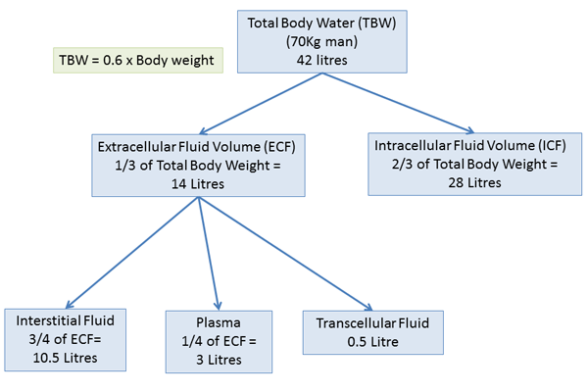
BODY FLUIDS

Slide 212
BODY FLUIDS
There are two main body fluid compartments;
Intracellular and extracellular.
Intracellular fluid equals 40% or 25-28 liters. Extracellular equals 20% or 14-15litres
and interstitial fluid is 15%.

Slide 213
BODY FLUID
Homeostasis and cell metabolism depends on the exchange of fluid between cells and extracellular compartment.
Normally there is a balance between intake and output of water.
Intake = H₂o ingested and H₂o in food + H₂o of oxidation
output = H₂o from kidney + H₂o from skin + lungs + GIT

Slide 214
DEHYDRATION
Excessive loss of body water leading to a decline in body water level is called dehydration.
Dehydration may be due to :
Simple water loss
Loss of both water and electrolytes

Slide 215
DEHYDRATION
Dehydration is seen in the under listed conditions
Excess body water loss as
in diarrhea
Severe vomiting
Excessive sweating
Fluid loss in burns
Addison’s disease
Diabetes mellitus and
Diabetes insipedus
Renal disease

Slide 216
DEHYDRATION
The clinical symptoms associated with severe dehydration
Low cardiac output
Rapid pulse rate
Low blood pressure
Decreased skin turgor
Acidosis
Sunken eye balls
Lethargy, confusion and
coma
Intracellular
dehydration may lead to
death.

Slide 217
DEHYDRATION
TREATMENT:
The replenishment of body with water and electrolytes.
Electrolytes and pH should be monitored
carefully.

Slide 218
OEDEMA
Abnormal accumulation of water in normally existing space in the body is called edema.
In most instances, edema occurs mainly in the extracellular fluid compartment, but it can involve intracellular fluid as well.
Intracellular edema: Results from
(1) depression of the metabolic systems of the tissues, and
(2) lack of adequate nutrition to the cells.

Slide 219
OEDEMA
Extracellular Edema
Extracellular fluid edema occurs when there is excess
fluid accumulation in the extracellular spaces.
There are two general causes of extracellular edema:
abnormal leakage of fluid from the plasma to the interstitial spaces across the capillaries, and
failure of the lymphatics to return fluid from the interstitium back into the blood.
The most common clinical cause of interstitial fluid accumulation is excessive capillary fluid filtration

Slide 220
OEDEMA
GENERALISED OEDEMA (CLINICAL CAUSES)
Cardiac failure is the most common course of generalized oedema.
It leads to sodium retention and H₂o with resultant increased blood volume and blood pressure.
The oedema fluid accumulate in mostly in the dependent parts of the body.
Nephrotic syndrome
Liver cirrhosis
Cushing’s syndrome,
Toxemia of pregnancy

Slide 221
OEDEMA
LOCALISED OEDEMA
Inflammaory Odema: Increased capillary permeability caused by chemical mediators due to increased osmotic pressure in tissues leading to extrusion of proteins
Hypersensitivity Reaction: Release of chemical mediators due to hypersensitivity reactions.
Impaired venous drainage: thrombosis, compression by external pressure as in ,enlarged uterus, tight cast on the body.
Lymphatic obstruction: e.g cancer; trauma etc

Slide 222
OEDEMA
Effects of Oedema
These are particularly seen in sub-cutaneous tissues, lungs and brain.
Subcutaneous tissues:
Pitting oedema, impaired wound healing and infections, oozing of fluid on section(cut)
Lungs:
The lungs get heavy and baggy. Fluid accumulation in bronchi and aveoli. Oedema is seen in congestive heart failure, adult distress syndrome(ARDS), infection of the lungs and hypersensitivity reaction.
Brain:
The gyri are swollen and flattened, the sulci narrowed and the ventricular system compressed, the white matter is soft and gelatinous

Slide 223
DERANGEMENT IN BLOOD VOLUME
This is the disturbance in the operation or functions of blood in the body.
Derangement in blood volume:
Hyperemia and congestion
Ischemia
Hemorrhage
Shock
Hyperaemia and Congestion: Hyperaemia and congestion both imply an increased volume of blood in the affected tissue or part.

Slide 224
DERANGEMENT IN BLOOD VOLUME
Hyperaemia is an active process, and refers to arteriolar dilation of sympathetic or humoral origin.
Examples include the muscle during exercise, or the changes of acute inflammation
Congestion is a passive process that results from impaired venous drainage, with passive distention of distal veins, venules and capillaries.
The affected part is red-blue owing to the deoxygenated blood.

Slide 225
DERANGEMENT IN BLOOD VOLUME
Ischemia: this is inadequate blood supply to a tissue or organ caused by partial or total obstruction of blood vessels.
The causes include arteriosclerosis, thrombosis, embolism, external pressure and mechanical obstruction.
Ischemia may be reversible, in which case the affected tissue will recover if blood flow is restored, or it may be irreversible, resulting in tissue death.
Ischemia can also be acute, due to a sudden reduction in blood flow, or chronic, due to slowly decreasing blood flow.

Slide 226
DERANGEMENT IN BLOOD VOLUME
The effects include necrosis, symptomless death of cells or temporary pain in chest or legs.
The effect depends on the severity of the reduction of blood supply, sensitivity and activity of tissue and its oxygen needs and the rapidity of the development of the ischemic process.

Slide 227
DERANGEMENT IN BLOOD VOLUME
Treatment of ischemia depends on the cause, but generally is aimed at restoring blood flow and reducing further tissue injury and death.

Slide 228
HEAMORRHAGE
Heamorrhage: Haemorrhage is the escape of blood due to rupture of a blood vessel.
It can be classified based on size and location of haemorrhage
Classification based on size
Petechial haemorrhage: minute haemorrhages (1mm-2mm) into skin, mucosae or serosa are called petechiae; they are usually associated with increased intravascular pressure, low platelet counts, defective platelet function, or clotting factor deficiencies.
These markings take the form of small red to purple spots.

Slide 229
HEAMORRHAGE
Purpura haemorrhage: larger haemorrhages (3mm-5mm) are called purpura and are associated with the same diseases as above, plus trauma, vascular inflammation (vasculitis) or increased vascular fragility.
Ecchymosis heamorrhage: this represents larger bleeding that is most often associated with sublethal destruction of blood vessels.
Hematoma heamorrhage: tumor like accumulation of blood which has escaped from partially severed blood vessels.

Slide 230
HEAMORRHAGE
Classification based on location
Haemothorax: this refers to collection of blood into the pleural cavity.( The pleural cavity is the space that lies between the pleura, the two thin membranes that line and surround the lungs.)
Haemopricardium: this is due to haemorrhage in the pericardial cavity. (The pericardial cavity is an anatomical space located between the outside surface of the heart and the pericardium of the heart, which is a tough fibrous membrane that surrounds and protects the muscle of the heart.)
Haemoperitonium: this is due to haemorrhage in the peritoneal cavity. (The peritoneal cavity is the fluid-filled gap between the wall of the abdomen and the organs contained within the abdomen).
Haemathrosis : collection of blood in joints.

Slide 231
HEAMORRHAGE
Types of haemorrhage
Acute Haemorrhage:
This results from massive blood loss associated with such pathological process as trauma as seen in road traffic accident, and gunshots wounds.
In acute blood loss, there is rapid response of the body to the blood loss depending on the severity of the loss.
A loss of less or equal to 15% of blood volume is rapidly compensated for with little or no change of blood pressure.
A loss of between 15-30% of blood volume leads to arteriolar constriction decreased cardiac output, low blood pressure, and tadycardia.

Slide 232
HEAMORRHAGE
A loss between 30-50% will lead to decreased cardiac output, hypotensive shock, shift of cardiac output and cerebral circulation.
With further loss, compensatory mechanism becomes inadequate, the patient losses consciousness and dies.

Slide 233
HEAMORRHAGE
Chronic haemorrhage: blood loss in chronic haemorhage results from prolonged established parthological process or diseases e.g chronic blood loss associated with peptic ulcer and blood loss from tumour conditions.
Tissue changes: there is ischemia of organs followed by fibrosis (formation of scar tissue)
Internal heamorrhage produces acute inflammatory responses in tissue, degeneration of RBC.

Slide 234
SHOCK
Shock is a condition characterized by a reduction in tissue perfusion and oxygen delivery below the levels required to meet normal demand.
This is as a result of reduction in cardiac output or in the effective circulatory blood volume.
The major cause of shock is the loss of blood and plasma.

Slide 235
SHOCK
Shock manifests as a collapse in the circulatory system resulting in fainting, cold sweating, chills, and disturbances in breathing
The cardiac manifestation may include palpitation and fast pulse rate.
Shock can be reversible or irreversible.
In reversible shock all the anatomic changes can be reversed to normal if the causative agent is removed.
When he causative agent becomes persistent, organ manifestation becomes irreversible and in many cases, death follows.

Slide 236
SHOCK
TYPES OF SHOCK
HYPOVOLAMIC SHOCK: This is circulatory volume deficit (cold shock) due to injury, haemorrhage, internal or external burns, operative traumas salt and H₂o depletions.
NORMOVOLAMIC SHOCK
Cardiogenic shock: This is myocardia damage from infection or diffuse myocardial disease. (Myocardial puing failure)

Slide 237
SHOCK
Peripheral vascular failure (septic shock): This is also known as lower resistance or warm shock.
It is caused by infection, gram ve sepsis or overwhelming gram +ve sepsis, abortions, diseases of GIT & wound – infections
Neurogenic shock: Dilatation of capacitance vessels through neurogenic mechanism due to loss of vascular tone
Anaphylactic shock: Initiated by generalised type I or II mediated hypersensitivity

Slide 238
SHOCK
Effect of Shock
Cutaneous tissues: a significant change is found here. There is dryness of the skin represented by dehydration. The skin becomes lax or loose depending on the degree of fluid loss from dehydration.
Brain tissue: the brain tissue becomes edematous and show death of the large neurons.
Heart: displays fatty changes, sub-endocardial haemorrage and necrosis
Lungs: are generally resistant when affected in shock due to bacterial sepsis. They show congestion and edema.
Kidney: one of the most severely affected of all organs.

Slide 239
Obstruction to Blood Flow.
Thrombosis
Embolism
Thrombosis
Thrombosis is the formation of a clotted mass of blood in the intact vascular system.
Three influences are involved (Virchow’s triad):
A. Endothelial injury,
B. Alterations in normal flow, and
C. Hyper-coagulability.
When the last two are present, thrombosis can occur without endothelial injury

Slide 240
Obstruction to Blood Flow.
Endothelial Injury
This is particularly important in the arteries and the heart, and is exemplified by ulcerative atherosclerosis with overlying thrombi
Other agents which damage the endothelium are the vasculitides, trauma, radiation, and some bacterial toxins
Dying endothelial cells release thrombotic (and some antithrombotic) factors, and collagen is exposed – this triggers the train of platelet and clotting events

Slide 241
Obstruction to Blood Flow.
Alterations in Normal Flow
Turbulence (in arteries) and stasis (in veins) disrupts the normal laminar flow;
platelets are allowed to come into prolonged contact with the endothelium and the slowed flow retards dilution of activated clotting factors and the inflow of inhibitors.
Turbulence itself may induce endothelial injury

Slide 242
Obstruction to Blood Flow.
Hypercoagulability of Blood Caused by the pathology of the intrinsic clotting of blood; primary (genetic) or secondary (acquired)
Morphology
Thrombi can form anywhere in the vascular tree; in high-flow vessels they tend to be non-occlusive, whereas elsewhere they tend to be occlusive.
On the arterial side, thrombi tend to be grey-red with alternating layers of platelets/fibrin and darker red cells giving “lines of Zahn”.
On the venous side, they tend to be red-blue, with thin strands of fibrin and generally no lines of Zahn.

Slide 243
EMBOLISM
Embolism can be defined as the introduction of intravascular solid, liquid or gas that is carried through the blood to impact at a site distant from its origin.
This is the transportation of undissolved material (embolus) in the blood stream and its deposition somewhere in the circulation.
Embolism are more frequently found in veins than in arteries

Slide 244
EMBOLISM
Etiology
Pulmonary Embolism: This is impaction of an embolus on the pulmonary circulation. It may result in sudden death.
Systemic Thromboembolism: This is more rare, and refers to emboli travelling within the systemic circulation
Fat Embolism:
It is most often seen after fractures of long bones with fatty marrows, but can occur with major trauma to fatty tissue, in diabetes mellitus, sickle cell anaemia and pancreatitis.

Slide 245
EMBOLISM
Amniotic Fluid Embolism: Uncommon (1 in 50,000 deliveries), thought to involve a tear in the placental membranes and introduction of amniotic fluid to the uterine or cervical veins.
The diagnostic feature is amniotic debris in pulmonary capillaries.
Air Embolism: It is the introduction of air into the vascular tree.
About 100mL is needed to become clinically significant.
The bubbles act like physical obstructions and may coalesce to form a frothy mass sufficiently large to occlude major vessels
Common cause include during delivery or abortion, etc.

Slide 246
INFARCTION
Infarction is ischaemic necrosis in an organ or tissue, resulting most often from sudden occlusion of its arterial supply.
It is rarely caused by obstruction of venous drainage usually in organs having no potential bypass channels such as the ovary or testis.

Slide 247
INFARCTION
Morphology
Infarcts are classified according to their colour, and the presence or absence of infection.
Red infarcts occur with venous occlusion (eg. ovary), in loose tissues (eg. lung), in tissues with a dual circulation (eg. small intestine), in tissues previously congested, and in sites where flow is re-established to a site of previous occlusion.
White infarcts occur with arterial occlusion, or in solid organs (heart, spleen, kidney).

Slide 248
INFARCTION
All infarcts tend to be wedge-shaped and often with a bit of fibrinous exudate.
An inflammatory exudate develops at the margins after a few hours and is well-defined by two days.
Most infarcts are ultimately replaced with scar tissue.

Slide 249
CARDIOVASCULAR DISEASES
The cardiovascular system consist of
A strong muscular heart
2. Blood vessels
3. Blood

Slide 250
The Heart
The heart is a hollow, muscular organ located between the lungs
It is a very effective pump that furnishes the power to maintain the blood flow needed throughout the entire body
The pointed lower end of the heart is known as the apex

Slide 251
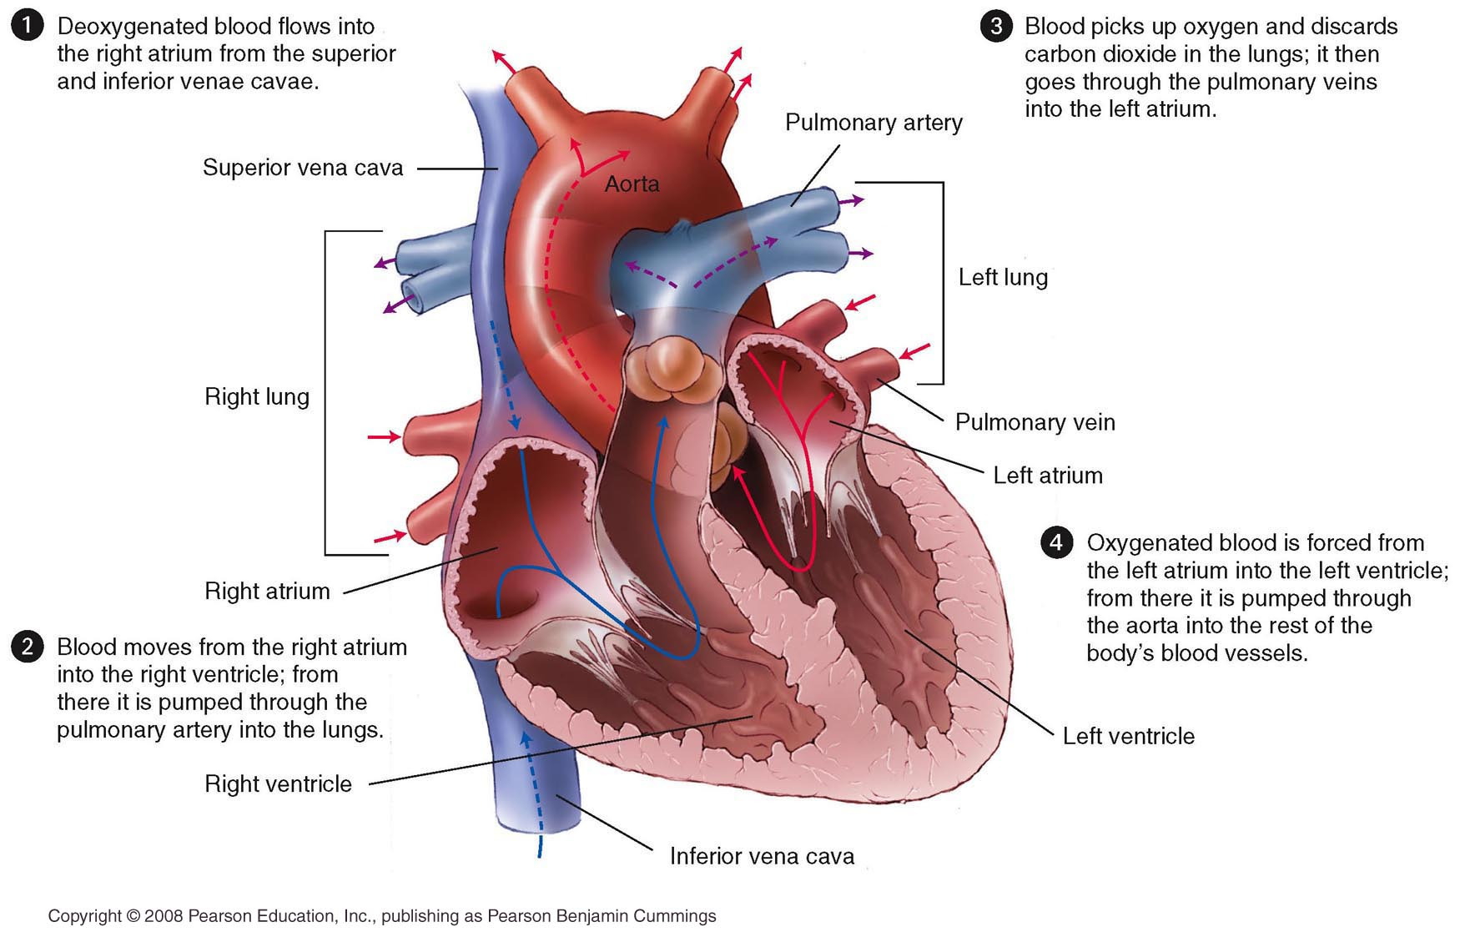
Anatomy of the Heart

Slide 252
The heart
The pericardium also known as the pericardial sac, is the double-walled membranous sac that encloses the heart.
The visceral pericardium, which is the inner layer of the pericardium, also forms the outer layer of the heart.
When referred to as the outer layer of the heart, it is known as the epicardium
Pericardial fluid is found between these two layers, where it acts as a lubricant to prevent friction when the heart beats

Slide 253
The heart
The walls of the heart
The walls of the heart are made up of three layers: the epicardium, myocardium, and endocardium
The epicardium is the external layer of the heart and the inner layer of the pericardium
The myocardium also known as myocardial muscle, is the middle and thickest of the heart’s three layers and consists of specialized cardiac muscle tissue
The endocardium which consists of epithelial tissue, is the inner lining of the heart.

Slide 254
The heart
The chambers of the heart
The heart is divided into left and right sides. Each side is subdivided to form the four chambers of the heart
The atria are the two upper chambers of the heart.
The ventricles are the two lower chambers of the heart..

Slide 255
The heart
The valves of the heart
The flow of blood through the heart is controlled by four valves:
The tricuspid, pulmonary semilunar, mitral, and aortic semilunar valves
The tricuspid valve controls the opening between the right atrium and the right ventricle
The pulmonary semilunar valve is located between the right ventricle and the pulmonary artery
The mitral valve, also known as the bicuspid valve, is located between the left atrium and left ventricle.
The aortic semilunar valve is located between the left ventricle and the aorta.

Slide 256
Types of Cardiovascular Diseases
Atherosclerosis
Hypertensive heart diseases
Ischaemic Heart Disease
Congenital heart disease
Rheumatic Heart Diseases
Heart failure
Tumours of the heart

Slide 257
Atherosclerosis
Atherosclerosis:
It is a specific form of arteriosclerosis in which an artery wall thickens as a result of invasion and accumulation of white blood cells and proliferation of intimal smooth muscle cell creating an atheromatous plaque.
Etiology
High amounts of certain fats and cholesterol in the body
High blood pressure
Diabetes (high amount of sugar in the blood due to insulin resistance)

Slide 258
Atherosclerosis
Morphological changes
The atheromatous plaque reduces the elasticity of the artery walls which increases pulse pressure.
Blockage of the arteries due to calcification and accumulation of lipids.

Slide 259
Hypertensive Heart Diseases
This includes a number of complications of high blood pressure that affects the heart.
Most patients of hypertensive heart disease have advanced coronary atherosclerosis and may develop progressive Ischemic heart disease.
Etiology: it is caused by high blood pressure
Eg of hypertensive heart disease is left ventricular hypertrophy

Slide 260
Hypertensive Heart Diseases
The most significant finding is marked hypertrophy of the heart, chiefly of the left ventricle.
The weight of the heart increases to 500 gm or more (normal weight about 300 gm).
The thickness of the left ventricular wall increases from its normal 13 to 15 mm up to 20 mm or more.
Clinically, there is an enlarged heart (cardiomegaly)

Slide 261
ISCHAEMIC HEART DISEASES
Ischaemic heart disease (IHD) is defined as acute or chronic form of cardiac disability arising from imbalance between the myocardial supply and demand for oxygenated blood.
Narrowing or obstruction of the coronary arterial system is the most common cause of myocardial anoxia so IHD is also called coronary artery disease (CAD’

Slide 262
ISCHAEMIC HEART DISEASES
Etiology
Coronary atherosclerosis
Non-atherosclerotic cause such as vasospasm, arteritis and embolism
Morphological changes
Left ventricular hypertropy and dilatation
Coronary arteries show atherosclerotic plaques and may have complicated lesions in the form of super- imposed thrombosis
Clinical manifestation include
High blood pressure
Myocardial infarction

Slide 263
Congenital Heart Diseases
Congenital heart diseases is the general term used to describe abnormalities of the heart or great vessels that present from birth.
ETIOLOGY
Problems with genes or chromosomes in the child.
Some medications or drugs or alcohol during pregnancy.
3. A viral infection like Rubella (German measles) in the mother in the first trimester of pregnancy.
4. Faulty Embryogenesis during gestational weeks 3 through 8, when there is major cardiovascular development
5. Family history of having CHD due to autosomal-dominant defects

Slide 264
Congenital Heart Diseases
Pathogenesis
Malpositions of the heart
Dextrocardia is the condition when the apex of the heart points to the right side of the chest.
Shunts (cyanotic congenital heart disease):
A shunt may be left-to-right side or right-to-left side of the circulation.
Obstructions (obstructive congenital heart disease)

Slide 265
Congenital Heart Diseases
Patent ductus arterosis
Occurs due to left-to-right shunt at the level of ductus resulting in increased pulmonary flow and increased volume in the left heart
Morphological changes include
venticular septal defect
atrial septal defect
Clinical manifestation include
Arrhythmias (abnormal heart rhythms)
Cyanosis (blue tinted skin)
Shortness of breath
Edema

Slide 266
Rheumatic Heart Disease
Rheumatic heart disease (RHD) is damage to one or more heart valves that remains after an episode of acute rheumatic fever (ARF) is resolved.
Etiology
It is caused by an episode or recurrent episodes of ARF, where the heart has become inflamed.

Slide 267
Rheumatic Heart Disease
Signs
The heart valves can remain stretched and/or scarred, and normal blood flow through damaged valves is interrupted.
Blood may flow backward through stretched valves that do not close properly, or may be blocked due to scarred valves not opening properly

Slide 268
Rheumatic Heart Disease
Clinical manifestations
Arrhythmias
Stroke
Endocarditis
symptoms depend on which heart valves are affected and the type and severity of the damage. They incclude:
Heart murmur
Chest pain
Breathlessness with physical activity or when lying down
Weakness and tiredness, and swelling of the legs and face.

Slide 269
VALVULAR HEART DISEASE
This is a disease characterized by damage to or a defect in one of the four heart valves: the mitral, aortic, tricuspid or pulmonary.
Valvular disease results in
stenosis or insufficiency (regurgitation or incompetence), or both.
Stenosis is the failure of a valve to open completely, obstructing forward flow
Insufficiency results from failure of a valve to close completely,thereby allowing regurgitation (backflow) of blood

Slide 270
VALVULAR HEART DISEASE
There are many different types of valvular heart disease.
They are either congenital or acquired.
The causes include
degeneration of heart valve with age
Rheumatic fever
Bacterial endocarditis
High blood pressure
Atherosclerosis
Drugs such as methysergide which is used to treat migraine headache

Slide 271
VALVULAR HEART DISEASE
Clinical features
General clinical features for valvular heart disease include
edema
Palpitation( irregular or fast heartbeat)
Chest pain
Fever
Rapid weight loss
dizziness

Slide 272
Heart Failure
Heart failure is defined as the pathophysiologic state in which impaired cardiac function is unable to maintain an adequate circulation for the metabolic needs of the tissues of the body.
It may be acute or chronic
Etiology:
Heart failure may be caused by one of the following factors, either singly or in combination;
INTRINSIC PUMP FAILURE.
The most common and most important cause of heart failure is weakening of the ventricular muscle due to disease so that the heart fails to act as an efficient pump.

Slide 273
Heart Failure
INCREASED WORKLOAD ON THE HEART
IMPAIRED FILLING OF CARDIAC CHAMBERS

Slide 274
Tumours of the heart
Tumours of the heart are abnormal growth of tumours forming a mass in the heart
They are classified into primary and secondary, the latter being more common than the former.
PRIMARY TUMOURS : Primary tumours of the heart are quite rare, found in 0.04% of autopsies.

Slide 275
Tumours of the heart
SECONDARY HEART TUMOURS
Metastatic tumours of the heart are more common than the primary tumours.
About 10% cases with disseminated cancer have metastases in the heart.
Most of these result from haematogenous or lymphatic spread

Slide 276
SYSTEMIC DISEASES
HYPERTENSION
DIABETES MELLITUS

Slide 277
HYPERTENSION
Hypertension is a sustained elevated blood pressure (BP) (systolic pressure of 140mmHg or greater and or diastolic pressure of 90mmHg or greater).
Normal BP is below 120/80mmHg.
BP between 120/80 and 139/89 is called pre-hypertension.
BP of 140/90 or above is considered high BP.

Slide 278
HYPERTENSION
The systolic BP represents the pressure in the arteries as the heart contracts & pumps blood into the arteries
The diastolic pressure represents the pressure in the arteries as the heart relaxes after the contraction.
The diastolic pressure therefore reflects the minimum pressure to which the arteries are exposed.

Slide 279
HYPERTENSION
Types of hypertension
There are 2 major types of hypertension and 4 less frequently found types.
The 2 major types are:
Primary or essential hypertension: also known as benign or idiopathic.
Secondary hypertension
other types:
Malignant hypertension
Isolated systolic hypertension
White coat hypertension
Resistant hypertension

Slide 280
HYPERTENSION
Primary / Essential hypertension
Primary hypertension is the most common type of hypertension diagnosed in about 95% of cases.
It has no obvious or identifiable cause.
It usually has its onset in the 20’s – 30s and it affects males more than females.
Secondary hypertension
Five to ten (5-10) percent of all hypertensive cases have an identifiable cause;
Removal of cause may not guarantee normal pressure.

Slide 281
HYPERTENSION
Secondary hypertension may be caused by the following:
Kidney damage or impaired kidney function. (This accounts for most secondary forms of hypertension)
Tumours or over activity of the adrenal gland.
Thyroid dysfunction
Medication e.g recreational drugs, oral contraceptives, corticosteroids, drinks & food.
Pregnancy related conditions.

Slide 282
HYPERTENSION
Other types of hypertension
Malignant
This is the most severe form of hypertension and is severe and progressive.
It rapidly leads to organ damage and unless properly treated, it is fatal within 5 years for the majority of the patients.
Death usually comes from heart failure, kidney damage or brain haemorrhage.

Slide 283
HYPERTENSION
Isolated systolic hypertension
In this case, the systolic BP is consistently above 160mmHg & the diastolic below 90mmHg.
This may occur in older age group and results from the age related stiffening of the arteries.
White coat hypertension
This is anxiety induced hypertension.
It means BP is only high when tested by a health professional.
Resistant hypertension
If BP cannot be reduced to below 140/90mmHg despite a triple drug regime, resistant hypertension is considered.

Slide 284
HYPERTENSION
Pathophysiology of essential hypertension
Essential hypertension develops from renal system dysfunction.
The kidney is a filtering organ that retains vital blood components & excrete excessive fluid.
Arterial pressure within the renal artery triggers a feedback loop. The kidney excretes sodium which osmotically draws fluid into the excretory system in a process called pressure diuresis which causes a decrease in blood fluid volume and arterial pressure.

Slide 285
HYPERTENSION
As pressure within the renal artery decreases, the kidney reflexly secrets an enzyme called renin which causes the formation of a protein called angiotensin I which directly stimulates the kidneys to retain Na & fluid.
Angiotensin I is converted in the lungs via the enzyme angiotensin converting enzyme (ACE) produced in the liver to angiotensin II.
Angioensin II is a potent vasoconstrictor which increases total peripheral vascular resistance & hence elevates B.P.

Slide 286
HYPERTENSION
In healthy individuals, the feedback loop maintains a constant BP with only minor fluctuation.
In patients with essential hypertension the feedback fails and the result is higher than normal level of pressure within the renal artery necessary for pressure diuresis to occur.

Slide 287
HYPERTENSION
The major pathophysiology includes the following:
1. Increased reactivity of resistant vessels & resultant increase in peripheral resistance
2. A sodium homeostatic effect. In essential hypertension the kidneys are unable to excrete appropriate amount of Na at any given BP, as a result sodium & fluid are retained and the BP increases.

Slide 288
HYPERTENSION
Risks or Predisposng factors for development of hypertension
Specific causes
Age. B.P tends to rise with age possibly as a result of decreased arterial compliance.
Genetics: History of hypertension tends to run in families.
Environment: Mental & physical stress increase BP. Removing the stress may not necessarily return the BP to normal.
Na⁺ intake: The salt study has confirmed a strong relation between hypertension, stroke & salt intake. Reducing salt intake in hypertensive individuals lowers BP.

Slide 289
HYPERTENSION
Alcohol. This is the most common cause of hypertension in the young.
It affects about 1% of the population
Weight:
Obese patients have a higher BP.
Up to 30% of hypertension is attributable in part or wholly to obesity.
Race. Caucasians have a lower BP than black populations living in the same environment.
Black population living in rural Africa have a lower BP than those living in town.
Black populations are genetically selected to be salt retainers & so are more sensitive to an increase in dietary salt intake.

Slide 290
HYPERTENSION
COMPLICATIONS OF HYPERTENSION
Ocular complications: Systemic hypertension can affect the retinal, choroidal and optic nerve circulations.
A variety of retinal vascular changes can be seen in hypertensive patients.
This depends in part on the severity and duration of the hypertension.
Hypertension is manifested in the eye as both hypertensive retinopathy & hypertensive ocular complications.

Slide 291
HYPERTENSION
Coronary heart disease: Excess work load on the heart leads to the development of congestive heart disease, coronary heart disease or both often causing death as a result of heart attack.
Coronary heart disease is the leading cause of death in hypertensive patients.
Ventricular hypertrophy occurs as a result of increased cardiac output in the face of systemic vascular resistance.
Eventually, the heart is unable to maintain this constant output and the hypertrophied muscle outstrips it O₂ supply.

Slide 292
HYPERTENSION
Cerebrovascular disease: The high pressure frequently ruptures major blood vessels in the brain followed by blood clotting and death of major portion of the brain.
This is cerebral infarct (clinically this called stroke). Depending on the part of brain involved, a stroke can cause paralysis, dementia, blindness or multiple other serious brain disorders.
Cerebrovascular disease is a serious complication of hypertension and hypertension is the leading cause of stroke.

Slide 293
HYPERTENSION
Renal failure: Very high pressure always almost causes multiple haemorrhages in the kidneys producing many areas of renal destruction and eventually kidney failure, coma and death.
Atherosclerosis and arteriosclerosis: High BP plays a significant role in the development of these.
High BP reduces elasticity of vessels allowing lipids to deposit in the form of atheromas which in turn leads to thrombus formation and possible emboli formation.
This impedes blood flow and leads to ischaemic disease.

Slide 294
DIABETES MELLITUS (DM)
Diabetes mellitus is a syndrome of impaired CHO, fat and protein metabolism caused by either lack of insulin secretion or decreased sensitivity of the tissues to insulin

Slide 295
DIABETES MELLITUS (DM)
There are 2 general types of DM.
Type I diabetes (IDDM)
also called insulin dependent diabetes mellitus
Type II diabetes (NIDDM)
also called non insulin dependent diabetes mellitus

Slide 296
DIABETES MELLITUS (DM)
In both types of DM, metabolism of all the main nutrients is altered.
The basic effect of insulin lack or insulin resistance to glucose metabolism is to prevent the efficient uptake and utilization of glucose by most cells of the body, except those of the brain.
As a result, blood glucose concentration increases,
Cell utilization of glucose falls increasingly lower, and utilization of fats and proteins increases.

Slide 297
DIABETES MELLITUS (DM)
Type I
This was formally known as insulin dependent diabetes mellitus.
It is also known as juvenile onset or ketone prone diabetes mellitus.
It usually begins at age 20 or less and it is defined by an absolute lack of insulin caused by a reduction in the B cell mass of the pancreas.
This may be the result of auto immune processes and may involve genetic susceptibility.
Approx 10% of diabetic cases are type I.

Slide 298
DIABETES MELLITUS (DM)
Type II-
Was formally known as non insulin dependent diabetes mellitus (NIDDM).
Sometimes referred to as adult onset diabetes mellitus.
It usually begins after age 40 and a multi factorial disease that may involve improper insulin secretion, malfunctioning insulin and or insulin resistance in peripheral tissues.
Approximately 90% of diabetic cases are type II.

Slide 299
DIABETES MELLITUS (DM)
There is a strong genetic component to developing this form of diabetes.
The most significant of other risk factors include obesity.
There is a direct relationship between the degree of obesity and the risk of developing type II diabetes and this holds true in children as well as adults.
Two metabolic defects characterize type II diabetes.
(1) Derangement in insulin secretion that is delayed or that is insufficient relative to the glucose load.
(2) inability of peripheral tissues to respond to insulin (insulin resistance).

Slide 300
DIABETES MELLITUS (DM)
Possible systemic signs and symptoms of DM include:
Hyperglycemia
Polyurea ( increased frequency of urination)
Polydipsia (increased thirst)
Polyphagia (increased appetite)
Glyosurea (deposition of glucose in urine)
Weakness (asthenia)
Weight loss
Nephropathy.

Slide 301
DIABETES MELLITUS (DM)
Feature | Type I | Type II
Age of Onset Body mass Plasma insulin | Usually < 20 years low to normal low or absent | Usually > 40 years Obese Normal to high
Plasma glucagon Plasma glucose | High, can be suppressed Increased | High, resistant to suppression. Increased
Insulin sensitivity Therapy | Normal Insulin | Reduced Weightloss, thiazolidinediones, metformin, sulfonylureas, insulin

Slide 302
DIABETES MELLITUS (DM)
Pathophysiology of diabetes mellitus
The pancrease plays a primary role in glucose metabolism by secreting the hormones insulin and glucagon.
Insulin is a hormone essential for proper metabolism of glucose and for maintenance of proper blood-glucose levels.
Inadequate secretion of insulin or inadequate structure or function of insulin or its receptors results in impaired metabolism of glucose, other carbohydrates, proteins and fats.
This is characterized by hyperglycaemia and glycosurea

Slide 303
DIABETES MELLITUS (DM)
Hyperglycaemia is the most frequently observed sign of diabetes.
Following a meal, glucose is absorbed into the blood.
In response to increased blood levels, insulin is secreted causing rapid uptake, storage of glucose by the tissues of the body.
Elevated glucose levels results in the formation of sorbitol (sugar alcohol).
Since sorbitol cannot readily diffuse through the cell membranes, cell edema and changes in function can result.

Slide 304
DIABETES MELLITUS (DM)
Ideal blood glucose values
Normal blood glucose level – 80-120mg/dl
Before meal – 72 – 126 mg/dl (4-7mmol/L)
90 mins after a meal – 180mg/dl.(less than 10mmol/L)
At bed time – 144 mg/dl (8mmol/L)

Slide 305
DIABETES MELLITUS (DM)
Physiology of Diagnosis
The usual methods of diagnosing diabetes are based on various chemical tests of the urine and the blood
Clinical tests for diabetes mellitus
Urinalysis –
It is a rapid method of testing grossly for diabetes mellitus. laboratories examine the urine specimen primarily for 2 components, glucose and ketones.
In general, a non diabetic loses undetectable amounts of glucose, whereas a diabetic loses glucose in small to large amounts, in proportion to the severity of disease and the intake of CHO.

Slide 306
DIABETES MELLITUS (DM)
The presence of glucose in the urine indicates insulin dysfunction
Ketones represent end product of fatty acid metabolism
When the body is unable to use carbohydrate as an energy source, fat becomes the predominant body fuel and ketones are then formed.
Presence of ketones in the urine represent a significant problem and advanced disease.

Slide 307
DIABETES MELLITUS (DM)
Blood testing
Most often, blood testing is the definite method of diagnosing diabetes mellitus and the preferred way of monitoring therapy
Fasting blood sugar (FBS)
Random plasma glucose (RPG)
Plasma insulin levels

Slide 308
DIABETES MELLITUS (DM)
Fasting blood sugar (FBS)
The most common screening method is the Fasting blood sugar test.
This test measures the level of blood glucose in the blood for a minimum of 8 hrs after food intake.
Normal values for FBS are: below 110 mg/dl
Values between 110-126 mg/dl-- impaired fasting glucose and suspects for diabetes.
Values > 126mg/dl on 2 or more separate occasions may be diagnosed with diabetes mellitus.

Slide 309
DIABETES MELLITUS (DM)
Random Plasma glucose (RPG)-
This is the measurement of serum glucose level at other times when the patient has not fasted.
RPG values of 200mg/dl or greater measured on 2 or more separate occasion when diabetes symptoms are present indicates a diagnosis of the disease.

Slide 310
DIABETES MELLITUS (DM)
Plasma insulin levels
In type I, plasma insulin levels are very low or undetectable during fasting and even after a meal.
In type II plasma insulin concentration may be several fold higher than normal and usually increases to a greater extent after ingestion of a standard glucose load during a glucose tolerance test.
Fasting level <25mIU/L or < 174 pmol/L
1 hour after glucose administration 30-230 mIU/L or 125-1917 pmol/L
(Milliinternational unit per liter)
(Picomole per liter)

Slide 311
DIABETES MELLITUS (DM)
Oral glucose tolerance test (OGTT) –
OGTT begins with the patient fasting for 8 hours and then drinking a syrupy beverage with glucose load equivalent to 75g to 1g.
2hrs after ingesting the liquid, serum glucose is measured.
Normal values for the OGTT are 140mg/dl or less. Values between 140 and 200mg/dl indicate impaired glucose tolerance
Values greater than 200mg/dl are consistent with diabetes

Slide 312
DIABETES MELLITUS (DM)
Glycosylated haemoglobin (HBA1c) Test
This refers to the end product of glucose binding with the Hb within RBC.
This is a natural occurrence in all individuals.
However in uncontrolled diabetic patients, there are much higher levels of ambient glucose in the blood and hence higher levels of glycosylated Hb.
Unlike urine testing or FBG which are essentially spot checks glycosylated Hb yields an assessment of blood sugar control over a1-3 mths period.
It is very valuable for monitoring patients compliance and effectiveness of therapy

Slide 313
DIABETES MELLITUS (DM)
The normal range for the hemoglobin A1c level is between 4% and 5.6%.
5.7% and 6.4% ….diabetes suspects
6.5% or higher …..diagnostic of diabetes

Slide 314
DIABETES MELLITUS (DM)
Ocular complications of diabetes mellitus
Large Changes in Refraction –
This may be the first sign of diabetic disease often myopic or hyperopic shifts are created as the lens swells secondary to sorbitol effects resulting in large refractive changes in what are otherwise noted as stable eyes.

Slide 315
DIABETES MELLITUS (DM)
Cataracts – The cataracts may mature quickly but have been documented to regress once sugar levels are stabilized.
Retinopathy – is a common eye complication among people with diabetes. It is a leakage of damage blood vessels in the retina and collapse or deterioration of blood vessels. The risks of retinopathy greatly increase, when the patients FBG is above 116mg/dl

